Slide 1
Module 1
Performing Basic Linux Tasks

Slide 2
Objectives
Describe the origins of the Linux operating system
Outline the key features of the Linux operating system
Identify the characteristics of various Linux distributions and where to find them

Slide 3

UNIX
What is UNIX?
🡪UNIX is probably one of the most versatile and popular OS found on today scientific and engineering (high-end) workstations / servers
🡪 UNIX is closed-source (proprietary) software.
🡪 UNIX is copyrighted (all rights reserved)

Slide 4
LINUX
What is LINUX?
🡪LINUX is UNIX-cloned OS that evolved from LINUX kernel.
🡪 LINUX is open-source software.
🡪 LINUX is park under GNU Public License (GPL) which is “copyleft” (all rights released)🡪 copy it freely, examine and modify the source code, and redistribute the software to others (free or priced) as long as the redistributed software is also passed along with the copyleft stipulation.
🡪E.g. sell service, support, warranty

Slide 5
History of UNIX and LINUX
http://en.wikipedia.org/wiki/Unix
UNIX philosophy
http://en.wikipedia.org/wiki/Unix_philosophy
http://en.wikipedia.org/wiki/Linux

Slide 6
Open Source versus Closed Source
Open source
Any program whose source code is made freely available / accessible for use or modification.
Closed source
The program source code is not released to the public. Closed source software usually appears in the form of compiled executable state.

Slide 7
Advantages of Open Source S/W
Ensures a large population of users.
Attracts a substantial crowd of developers to work around open source software projects and shared across the communities.
Enables the unlimited tuning and improvement of a software product. (evolve)

Slide 8
Overview of UNIX / LINUX features
Multitasking
Multiuser
Programmable shells
Device independence
Communications and networking
Open systems portability

Slide 9
Multitasking
UNIX/LINUX is a multiprocessing, multiuser system.
At any given point, you can have many processes running on UNIX/LINUX.

Slide 10
Multiuser
allows for multiple users to use the same computer at the same time
-Example: Unix server where multiple remote users (e.g Alice, Bob, Catherine) have access (such as via Secure Shell) to the Unix shell prompt at the same time.

Slide 11
Programmable shells
Following are the different types of Unix shells:
B shell - /bin/sh – This is the default Unix shell for many Unix operating systems .Bourne shell was written by S. R. Bourne
C-shell -/bin/csh -was designed to provide the interactive features lacking in b shell such as job control and aliasing .
K shell -/bin/ksh – was created by David Korn and has features of both B shell and C shell along with some additional features .
Bash – /bin/bash - the Bourne again shell was developed by GNU project .It is based on B shell language and has features of C and K shells.
tcsh -/bin/tcsh is the default shell of FreeBSD and its descendants. FreeBSD (Berkeley Software Distribution) is an operating system for a variety of platforms which focuses on features, speed, and stability.

Slide 12
Device independence
Most of Linux is independent of the hardware it runs on, and most users can be (happily) unaware of hardware issues.
Partial list of hardware platforms on which Linux can run:
-Intel -M68K
-Itanium -PA-RISC
-Mainframe (S/390) -Ultra-SPARC
-ARM -PowerPC
-Alpha -SPARC
-MIPS
Can be customized to work on mobile and embedded devices

Slide 13
Communications and networking
Unix/Linux supports a number of methods for data communication and networking.
This includes serial communications, TCP/IP (Transmission Control Protocol/Internet Protocol), and UUCP (UNIX-to-UNIX Copy Protocol).

Slide 14
Open systems portability
LINUX is UNIX-cloned OS that evolved from unix kernel.
LINUX is open-source software.
Any program whose source code is made freely available / accessible for use or modification.

Slide 15
Linux distribution
A Linux distribution (often abbreviated as distro) is an Linux operating system made from a software collection, which is containing the Linux kernel and libraries, combined with add on software (e.g. installation programs, management tools, etc.)

Slide 16
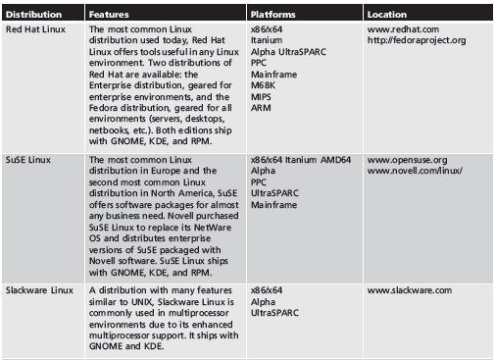
Linux Distributions (continued)
Common Linux distributions

Slide 17
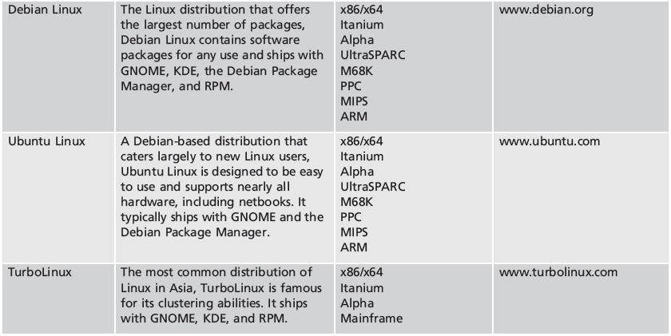
Linux Distributions (continued)
Common Linux distributions

Slide 18
Kernel VS Shell
Kernel
The core of an OS that has complete control over everything that occurs in the system.
Kernel interacts with the hardware (CPU, memory, devices) directly and provides basic services for computer operations.
* kernel does not talk to user directly but through the shell

Slide 19
Continue…
Major functions of kernel are:
Allocate the computer resources (CPU, memory etc)
Control access to the computer
Maintain file system
Handle interrupts
Handle errors
Perform I/O

Slide 20
Continue…
The kernel is the first part of OS to be loaded into memory (protected memory area) during booting and it remains there for the entire computer session.

Slide 21
Continue…
Shell
Is a command line interpreter.
A utility program designed to accept command from user and execute them.
An interface between user and kernel

Slide 22
Continue…
Outermost part of an OS that interacts with user commands.
Kernel (the innermost part) does not interact directly with the user, but rather interacts with the shell and / or other programs.

Slide 23
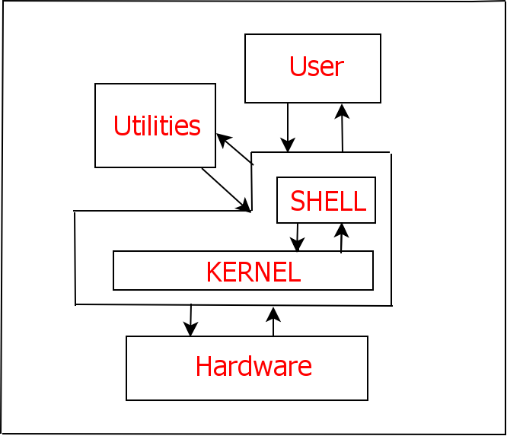

Continue…

Slide 24
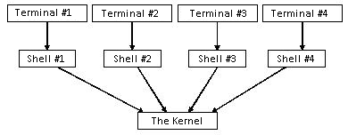
Continue…
Shell: user interface which accepts user inputs and transfers them to the kernel
Shell starts up when a user log on through the terminal.
Linux allows multiple terminals, each with its own shell

Slide 25
Basic Shell Commands
Commands: indicate name of program to execute
Case sensitive
Options: specific letters starting with “-” appearing after command name
Alter way command works

Slide 26
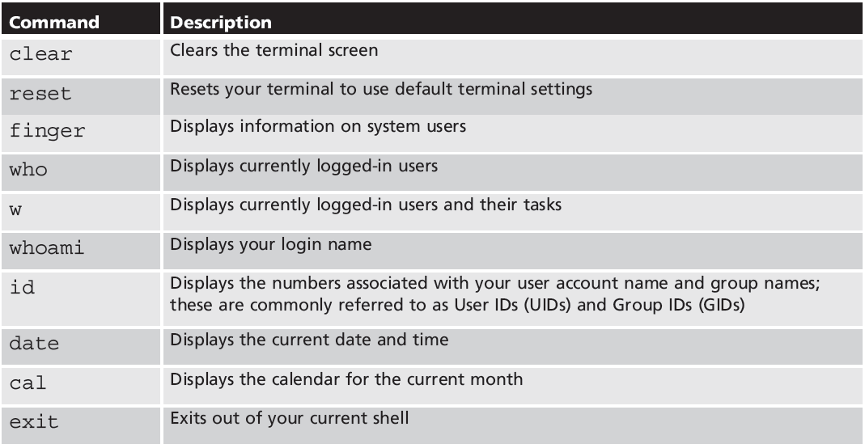
Basic Shell Commands (continued)
Some common Linux commands

Slide 27
Basic Shell Commands - Maintain the system time
To view and set date and time
*set time requires superuser privilege
Command | Function
date | To list the date and time of the server.
date -s “datestr” | To set time and date to the value specified. Eg. “11/20/2003 12:48:00”

Slide 28
Continue…
To show calendar
Command | Function
cal | To show calendar of the month.
cal month year | To show calendar of the specified month and year.

Slide 29
Exercise:
Write the output for date command using each of the following format:
$date “+This is the date: %B”
Answer:
Write a command to show the date using each of the following format:
Date: 27 September 2017
Answer:
Today is Wednesday (27/9/2017)
Answer:
Date Today: 27-9-2017 & Time Now: 10:00 AM
Answer:

Slide 30
Getting Command Help
Manual (man) pages: most common form of documentation for Linux commands
At command prompt, type “man” followed by command name
Contain different sections
Searchable by keyword
Info pages: set of local, easy-to-read command syntax documentation
At command prompt, type “info” followed by a command name

Slide 31
Common parts of a man page
Section name | Purpose
NAME | Provides the name of the command and a very brief description.
SYNOPSIS | Provides examples of how the command is executed. See below for more information.
DESCRIPTION | Provides a more detailed description of the command.
OPTIONS | Lists the options for the command as well as a description of how they are used. Often this information will be found in the DESCRIPTION section and not in a separate OPTIONS section.
FILES | Lists the file that are associated with the command as well as a description of how they are used.
AUTHOR | The name of the person who created the man page and (sometimes) how to contact the person.
REPORTING BUGS | Provides details on how to report problems with the command.
COPYRIGHT | Provides basic copyright information.
SEE ALSO | Provides you with an idea of where you can find additional information. This also will often include other commands that are related to this command.

Slide 32
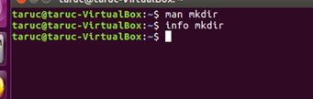
Getting Command Help

Slide 33
Access and Use man Pages
Key Command | Description
Space | Page one screen forward
b | Page one screen backward
PageDown | Page half a screen forward
PageUp | Page half a screen backward
Down-arrow, Enter | Jump one line forward
Up-arrow | Jump one line backward
End | Go to end of the manual page
Home | Go to beginning of manual page
/expression | Search forward from the current cursor position for expression, match line displayed as 1st line on the screen
?expression | Search backward from the current cursor position for expression, match line displayed as 1st line on the screen
n | Move to next instance of expression in the search
N | Move to previous instance of expression in the search
q | End display of the manual page

Slide 34
Man page sections
Enter this command: man man
Man pages are placed into sections. There are nine standard sections:
Executable programs or shell commands
System calls (functions provided by the kernel)
Library calls (functions within program libraries)
Special files (usually found in /dev)
File formats and conventions, e.g. /etc/passwd
Games
Miscellaneous (including macro packages and conventions), e.g. man(7), groff(7)
System administration commands (usually only for root)
Kernel routines [Non standard]

Slide 35
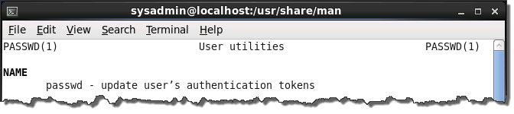
Determining which section
The section number of manual is enclosed in parentheses when viewing a man page.

Slide 36
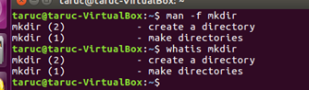
Searching the sections
To match man pages that have names that match a term, you can use the man command with the -f option.
The command whatis term is equivalent to the man -f term.

Slide 37
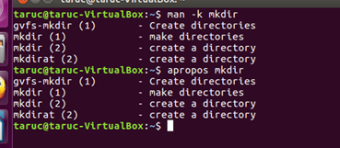
Searching man pages by keyword
The man command has an option, -k, which takes a keyword as an argument.
Executing man -k keyword, will search all the man pages descriptions for the keyword.
The apropos command is equivalent to using the man command with the -k option.

Slide 38
Specifying a section
If the command or file exists in more than one section of the manual, then it may be necessary to specify a manual section in order to view the correct man page.
For example, mkdir is found in both sections 1 and 2. To view both mkdir man pages, the following commands could be executed:
man 1 mkdir
man 2 mkdir

Slide 39
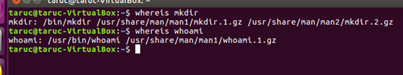
Finding commands and documentation
The whereis command will display the location of a command executable, as well as its source and documentation, if available.

Slide 40
Module 2
Managing Files in Linux

Slide 41
Exploring Linux File System
Understand the FHS
The file system concept in Linux involves a hierarchical system that can be depicted in a form of tree.
This structure of the file system is so called File System Hierarchy Standard (FHS).
It specifies which directories must be located on the first level after the root directory and what they contain.
It begins at the root (/), and branches out like the branches of a tree.
LINUX treats everything as file (ie. files include directories and various hardware components)

Slide 42
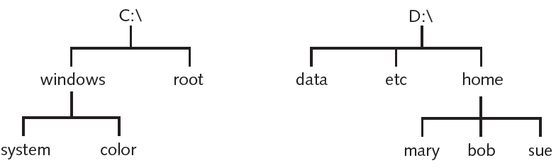
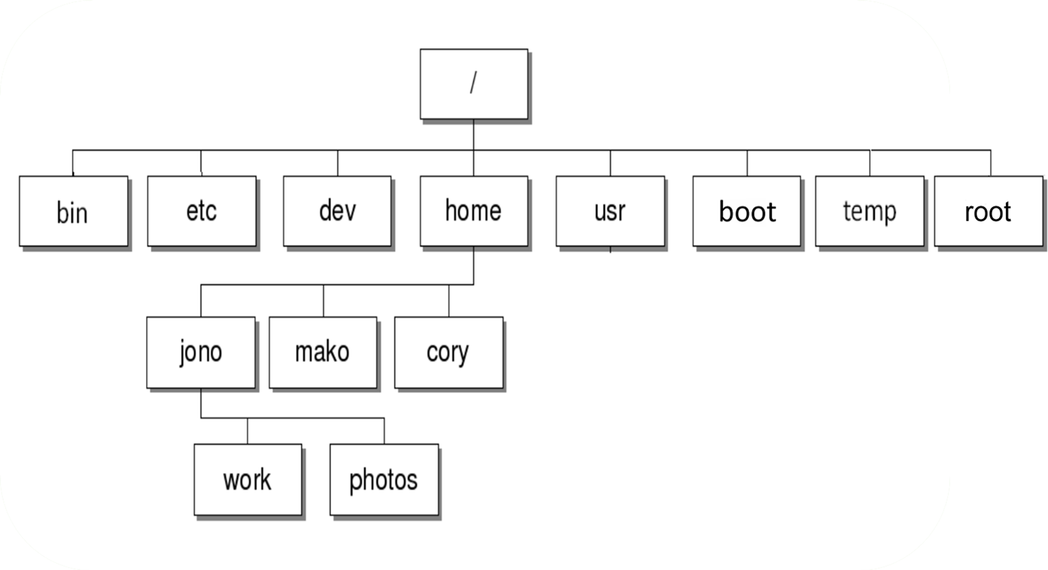
Understand the FHS (tree-like structure)
The Windows filesystem structure
System-related Directories
The root
The Linux filesystem structure

Slide 43
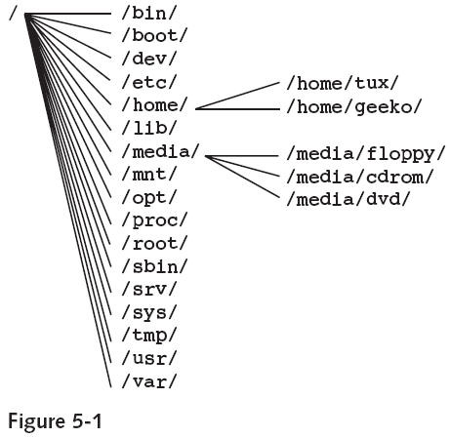
Exploring Linux File System
Understand the FHS
root
path

Slide 44
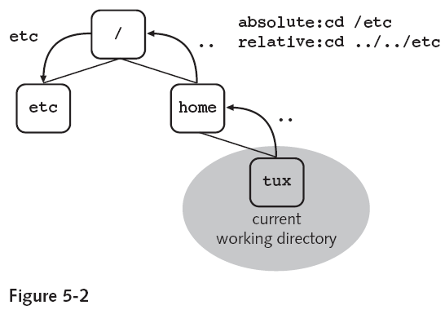
Exploring Linux File System
Understand the FHS
A file in this directory tree is uniquely defined by its path.
The path can be specified in two ways:-
As a relative path starting from the current directory.
As an absolute path starting from the root of the entire file system tree.

Slide 45
Exploring Linux File System
Understand the FHS
Working Directory
Our current directory is the one that we are in at any point in a session.
When we start, the working directory is our home directory.
Parent Directory
It is immediately above the working directory.
Referred to by .. (two dots)
45

Slide 46
Exploring Linux File System
Understand the FHS
As a relative path starting from the current directory
When we start, we are in our home directory, which is different from the root (/) directory. Our current, or working, directory is the directory we are in.
46

Slide 47
Exploring Linux File System
Understand the FHS
As an Absolute path starting from the root of the entire file system tree.
Example: Absolute path
Files | File Absolute Pathname | Directory Absolute Pathname
file1 | /etc/file1 | /etc
file2 | /home/john/file2 | /home/john

Slide 48
Exploring Linux File System
Understand the FHS
To change into the /etc directory, you can use the following command:-
48

Slide 49
Exploring Linux File System
Understand the FHS
Root Directory (/) is the highest level of the file system tree

Slide 50
Exploring Linux File System
Understand the FHS
Directories | Description
/ | Root Directory: the highest level of the file system tree
/bin | Holds essential Binaries for use by all users: it contains important executable programs. E.g. /bin/cat, /bin/rm, /bin/cp
/boot | Boot Directory: holds files necessary to boot the system such as the Linux kernel and associated configuration files. It contains static files of boot loader GRUB – for boot process
/dev | Populated with files that represent hardware devices and other special files, such as the /dev/null and /dev/zero files.
/etc | Holds configuration Files of Linux system, similar to control panel in windows : E.g. /etc/inittab, /etc/group, /etc/hosts
/home | User Directories: user own area in which to work with files
/lib | Libraries: It contains the libraries that are used by programs in the /bin and /sbin directories
/media | Mountpoints for Removable Media
/mnt | Mountpoint for Temporarily Mounted File System
/opt | Application Directory: Store Installed programs. E.g. /opt/GNOME Optional third party software installation location

Slide 51
Exploring Linux File System
Understand the FHS
Directories | Description
/proc | A virtual filesystem for the kernel to report process and other information. Holds process Files
/root | Home Directory of the Administrator (root user)
/sbin | System Binaries: contains important system binaries/programs for administration. E.g. /sbin/fdisk
/srv | Data Directories for Services: E.g. /srv/ftp
/sys | System Information Directory: A virtual filesystem holding information about hardware devices connected to the system.
/tmp | Temporary Area: Directory where all users are allowed to create temporary files that is supposed to be cleared at boot time (but often is not)
/usr | Second hierarchy of non-essential files for multi-user use: Unix System Resources – app. Programs, GUI, additional libraries
/var | Variable Files: It contains files that can be modified while system is running

Slide 52
Exploring Linux File System
Understand the FHS
Root Directory (/)
It is the highest level in the hierarchy. It is the root of whole file structure therefore it does not have a parent directory.
Normally only directories are located here, not files.
It has several levels of subdirectories.
User Directories (/home)
Every user on a Linux system has his own area in which to work with files. When a user logs in, he is in his own home directory.
E.g. /home/amy, /home/bobby, /home/mike
It contains any files we create while in it and may contain individual configuration files.
These configuration files are hidden files, so usually not displayed by the ls command.

Slide 53
Be reminded …
Windows separates directories using back slash(“\”) while different LINUX uses forward slash (“/”).
LINUX is case sensitive while Windows is not.
E.g. As such it is possible to have two or more files and directories with the same name but letters of different case.

Slide 54
Be reminded …
Spaces are critical in LINUX.
E.g. Spaces in file and directory names are perfectly valid but we need to be a little careful with them.
If we wanted to move into a directory called Holiday Photos
cd Holiday Photos 🡪 this will not work
cd “Holiday Photos” 🡪 this will work
cd ‘Holiday Photos’ 🡪 this will work
Windows uses a volume-based file hierarchy while LINUX uses a unified scheme.
E.g. Windows uses letters of the alphabet to represent different devices and different hard disk partitions. eg: c: , d: , e: etc.. while in linux " / " is the main directory (so called root directory as the top most layer of the linux file system).

Slide 55
Viewing Files and Directories: File Types
Text files: store information in a readable text format, contain configuration information
Binary/Executable program files: store information associated with executable programs
Directory files: serve as placeholders to organize other files

Slide 56
Viewing Files and Directories: File Types (continued)
Linked files: associated with another file
Special device files: represent system devices
Named pipes: identify channel that passes information between processes
Socket files: allow a process on another computer to write to a local file

Slide 57
Filenames
Filename: identifier given to a file
Up to 255 characters
Can use alphanumeric characters, dash (-), underscore (_), and dot (.)
Filename extensions: identifiers following a dot (.) at end of filename
Denote file type
Most files on Linux do not have filename extensions

Slide 58
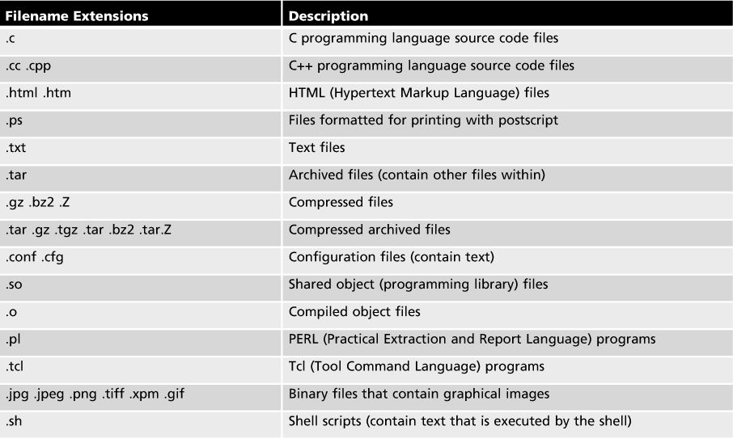
Common filename extensions

Slide 59
Changing Directories
Home directory: unique to each user
~ metacharacter used to refer to home directory
pwd (print working directory) command: displays current directory in the directory tree
cd (change directory) command: change the current directory in the directory tree
Argument specifies the destination directory
Tab-completion: pressing the Tab key fills in remaining characters of a unique filename or directory name
BASH shell feature
Alerts user if there is more than one possible match

Slide 60
Continue…
Directories navigation
cd command: To change / switch directories.
Command | Function
cd | Change from any directory to the home directory
cd /home cd ~ | Go to the directory /home (absolute path) Go to /home/user (the user’s home directories)
cd / | Go to root (NOT “/root”)
cd .. | To move one directory level higher
cd ../.. | To move two directory levels higher
cd - | To go to the last valid directory

Slide 61
Listing Files
ls Command: List the files in a directory
May pass an argument indicating the directory to be listed
Option | Description
(None) | Displays the content of the current directory in several columns
-a | Also displays hidden files (such as .bashrc)
-F | After each name, a character indicates the file type
-l | Long file listings - gives a detailed list of all files.
-t | File are sorted by date of alteration (newest first). Combined with the option –r, the output takes place in reverse order
-R | Output is recursive, including all subdirectories
-u | Sorted by date of the last access

Slide 62
Listing Files (continued)
Long listing for each file includes seven components
File type character + List of permissions (mode of the file)
Hard link count
Owner
Group owner
File size
Most recent modification time
Filename

Slide 63
Listing Files (continued)
Alias: shortcut for a command
ll command: Alias for ls -l
Hidden files: files not normally displayed to user
Configuration files often hidden
Filenames start with a dot (.)
ls –a command: displays hidden files

Slide 64
Continue…
To view command-line history
Command | Function
Press the up arrow key/down arrow key | To recall the command line

Slide 65
Continue…
Multiple Command Entry
To execute more than one command on the command line by separating each command with a semicolon (;)
$ date ; who
The date command produces the first line of the output. However, the remainder of the output is the result of the who command

Slide 66
Continue…
To check for file type
Command | Function
file filename | To determine the type of the specified object as LINUX files not necessary have file extensions.

Slide 67
file *
Below is an example of what may appear when running file with a wildcard for all files:
shutdown.htm: HTML document text
si.htm: HTML document text
side0.gif: GIF image data, version 89a, 107 x 18
robots.txt: ASCII text
routehlp.htm: HTML document text

Slide 68
Hints
LINUX files are color coded.
Common color codes:
Blue 🡪 directory
Green 🡪 executable file
White 🡪 normal file
Cyan 🡪 symbolic link

Slide 69
Useful Keyboard Shortcuts
Key Combination | Function
Ctrl+A | Move cursor to the beginning of the command line.
Ctrl+E | Move cursor to the end of the command line.
Ctrl+C | End a running program and return to the prompt.
Ctrl+D | Log out of the current shell session.
Ctrl+L | Clear this terminal.
Ctrl+R or type history command | Search command history.
q | Leave the page

Slide 70
Ctrl + R
"reverse-i-search."
Type a letter like “c” and you'll get a match for the most recent command in your history that starts with c. Keep typing to narrow your match. When you hit the jackpot, press Enter to execute the suggested command.

Slide 71
Create and View Files
Create a New File with “touch” command
Command | Description
touch <file> | Create a file (with no contents)
touch <file1> <file2> | Create 2 or more file
-a -m -r file -t time | Changes only the time of the last read access Changes only the time of the last modification Set the time stamp of file instead of the current time e.g. touch –r file2 file4 or touch –reference=file2 file4 Sets time using [[CC]YY]MMDDhhmm[.ss] instead of current time E.g. touch –t 201712251830.00 file5

Slide 72
Create and View Files
View a File with “cat” command
concatenate command
You can use cat to view the contents of a file
The command must include the filename of the file you want to see
Command | Description
cat <pathname/filename> | View the file contents

Slide 73
View/Displaying Content of Text Files
Large text files can not be viewed using the cat command, because the screen will only fit a portion of the file
more command: displays text files page-by-page
Pressing Spacebar displays the next page
Pressing Enter displays the next line
less command: same as more command but with more functions, e.g. can also use cursor to scroll. Besides, even compressed files (such as .gz and .bz2) can be displayed
Notes:
Source code is often packed for download as a TAR (Tape ARchive) file, that is a standard format in the Unix/Linux world. These files have a .tar extension; they can also be compressed, the extension is .tar.gzor .tar.bz2 in these cases
https://wiki.haskell.org/How_to_unpack_a_tar_file_in_Windows

Slide 74
Create and View Files
View a File with “more” or “less” command
less or more command displays the contents of a file page by page.
Command | Description
less <pathname/filename> OR more <pathname/filename> | View the file contents

Slide 75
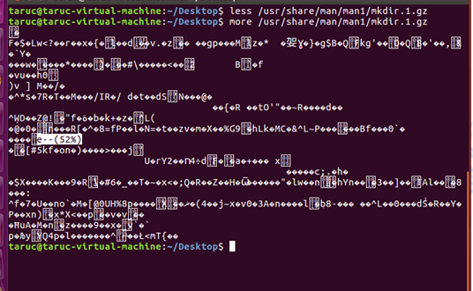

Slide 76
Create and View Files
View a File with “head” and “tail” command
Used to view the first or last lines of a file
By default, they show ten lines
head -20 or head –n 20 displays the first twenty lines
tail -5 or tail –n 5 displays the last five lines
tail -f displays a continuously updated view of the last lines of a file
To exit tail –f, press Ctrl+c
Command | Description
head -<no of lines> <filename> tail -<no of lines> <filename> | View the file contents

Slide 77
Exercise
Add the following contents into file1:
Line one
Line two
Line three
Line four
Line five
Answer:
Display all the contents from file1
Answer:: cat file1 less file1
Display the first three lines from file1
Answer: head -3 file1 or head –n 3 file1
Display the last two lines from file1
Answer: tail -2 file1 or tail -n 2 file1
77

Slide 78
Using Vi Editor

Slide 79
vi Text Editor
Visual editor
Standard UNIX/LINUX text editor
“unfriendly beast of an editor” – www.lowfatlinux.com
Not user-friendly, not easy to use and no clear indicators on mode
There are two basic modes of vi:
Command Mode and Input Mode

Slide 80
Command Mode
The default mode in vi.
Letter(s) typed in this mode will be interpreted as commands, without explicitly pressing <Enter>.
Always press <Esc> if you wish to switch back to Command Mode.

Slide 81
Common Command Mode’s keys
Key | Functions
→, ←, ↑, ↓ | Move cursor to specific locations.
$ | Move cursor to end of line.
^ | Move cursor to beginning of line.
:1 | Move to first line of file.
:$ | Move to last line of file.
x | Delete the character at the cursor position.
dd | Delete the current line.
p | Paste data that was cut with x or dd commands.
u | Undo.
yy | Copies the line in which the cursor is located
/ <word> | Search a word
k | Move one line up
j | Move one line down
h | Move a character left

Slide 82
Continue…
Key | Functions
:w | Write file to disk, without exiting editor.
:wq or :x | Write file to disk and quit.
:q! | Force quit
ZZ | Put the file to “sleep”.
:w filename | Saves the current file under the name file.

Slide 83
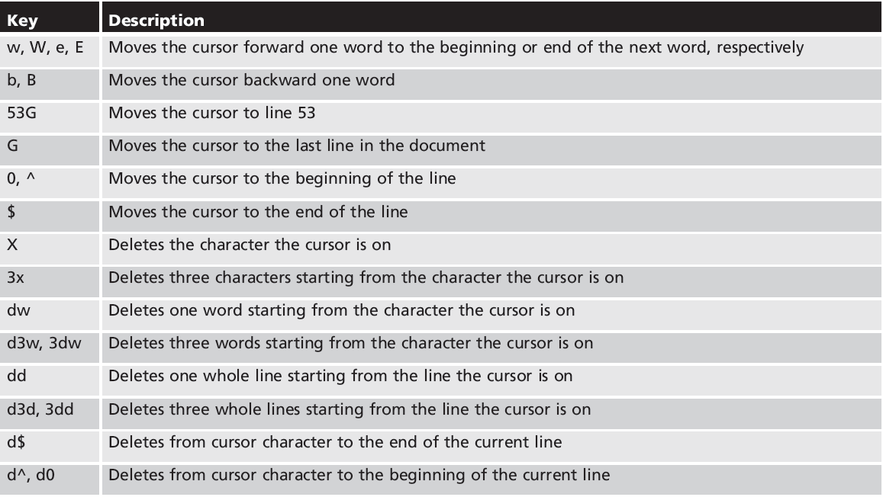
Editing Text Files: The vi Editor (continued)
Additional Key combinations commonly used in command mode

Slide 84
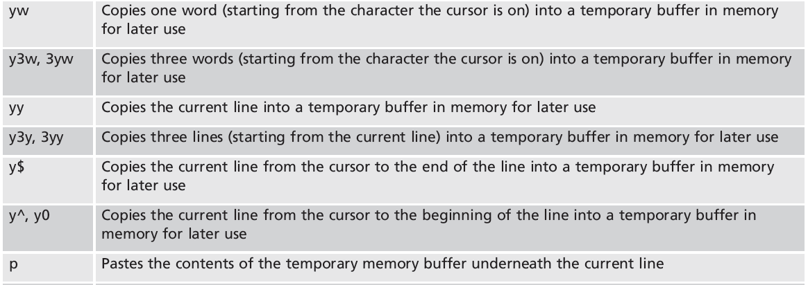
Editing Text Files: The vi Editor (continued)
Additional Key combinations commonly used in command mode

Slide 85
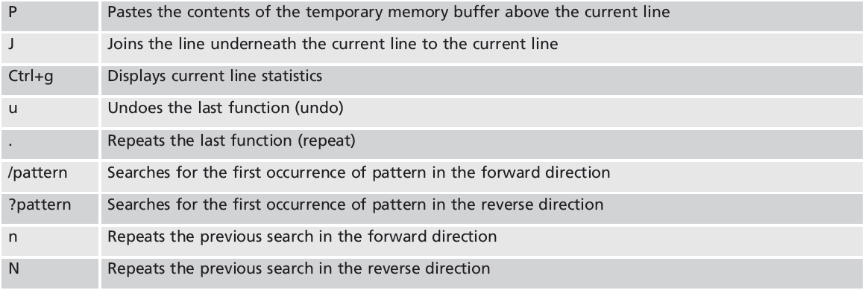
Editing Text Files: The vi Editor (continued)
Additional Key combinations commonly used in command mode

Slide 86
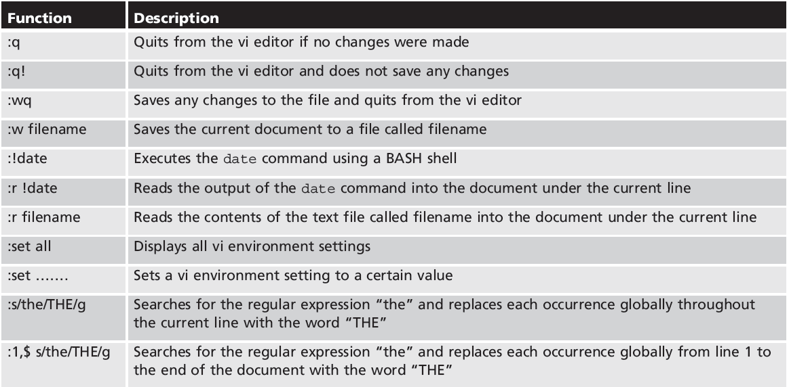
Editing Text Files: The vi Editor (continued)
Additional Key combinations commonly used at the command mode

Slide 87
Input Mode
A user needs to be in Input Mode for editing and inserting new characters.
Appropriate command key(s) need to be entered in order to activate Input Mode from Command Mode

Slide 88
Common Input Mode’s keys
Key | Functions
a | Insert text after the cursor.
i | Insert text before the cursor.
R | Replace text starting at the cursor.
o | Insert a new line after the current one.

Slide 89
Other Common Text Editors (continued)
gedit editor: a graphical text editor functional in a GUI environment
Does not have advanced functionality like vi and Emacs
Easiest editor to use
Functionality is analogous to the Windows Wordpad and Notepad editors

Slide 90
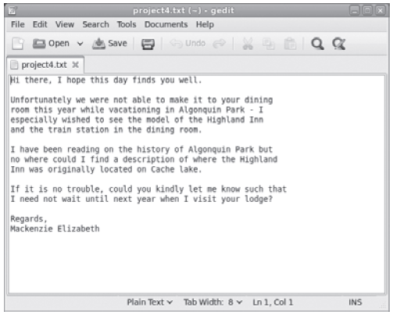
Other Common Text Editors (continued)
Figure 3-4: The gedit text editor

Slide 91
Move Files and Directories
“mv” command
mv source destination
Command | Description
mv <filename> <directory> | Move the file / Rename of a file 🡪mv renames file/directory SOURCE to DEST, or moves the SOURCE file (or files) into DEST directories or moves directory_A into DIRECTORY_B.
Option | Description
-i | Ask for confirmation before moving or rename a file
-u | Only moves files that are newer than the target files or when the destination file is missing

Slide 92
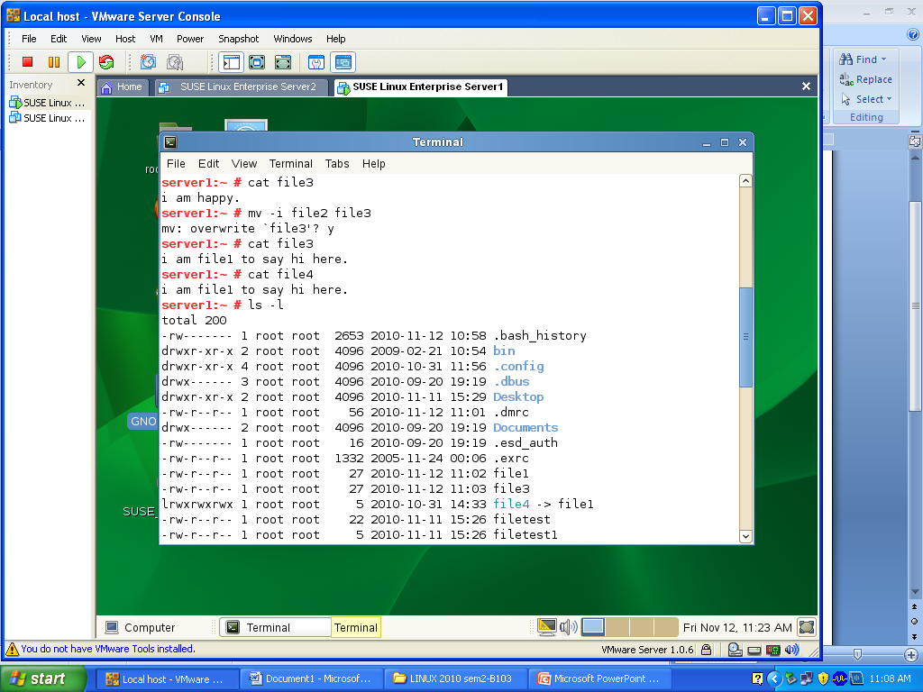

Slide 93
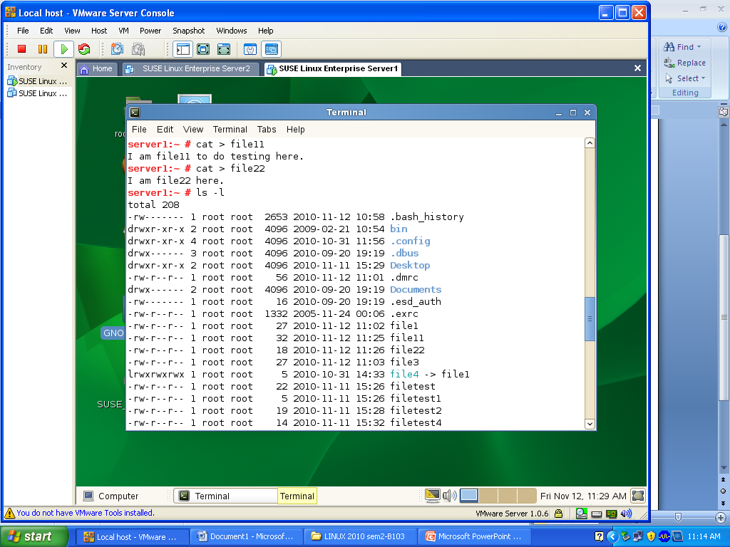
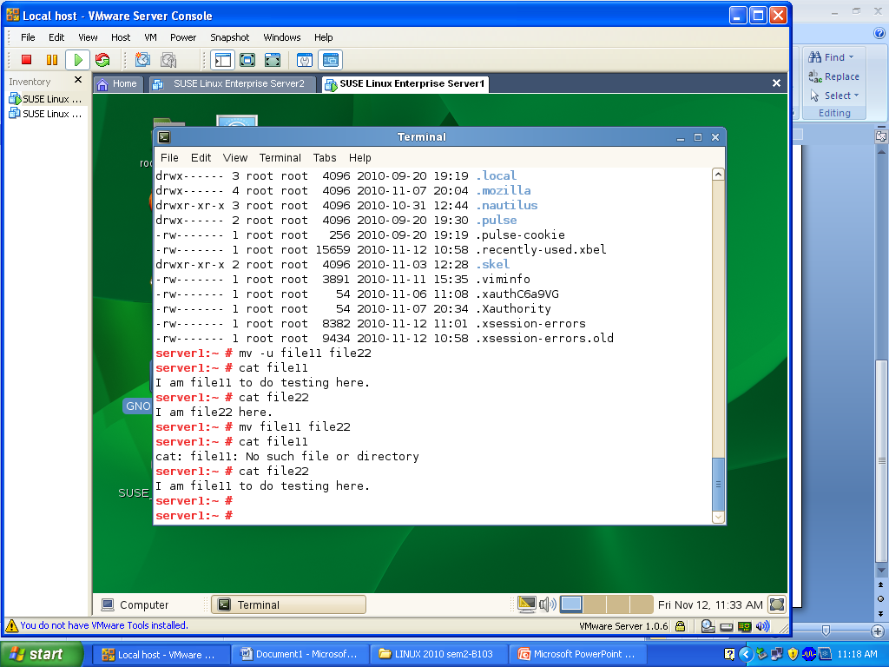

Slide 94
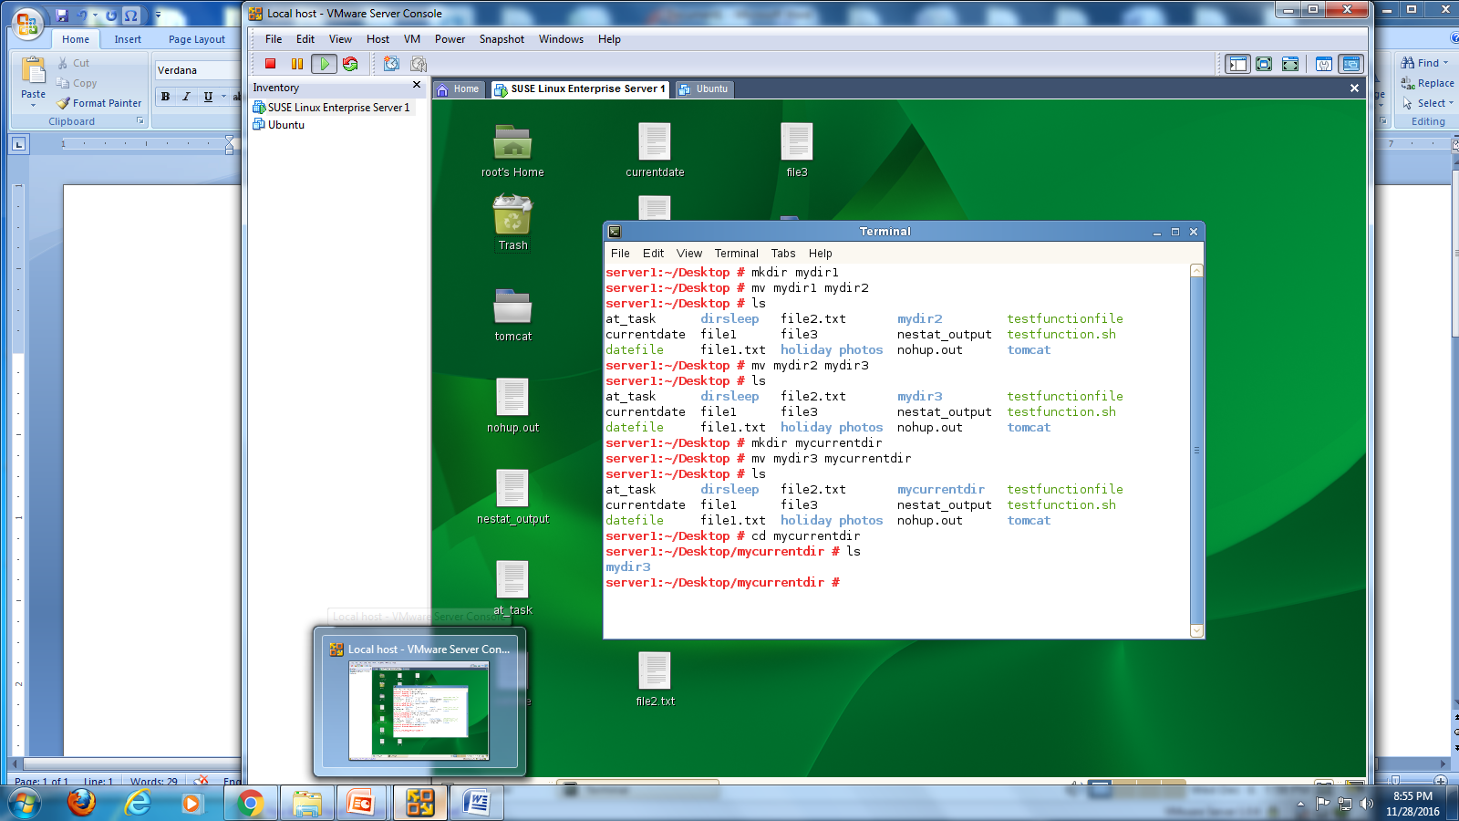

Slide 95
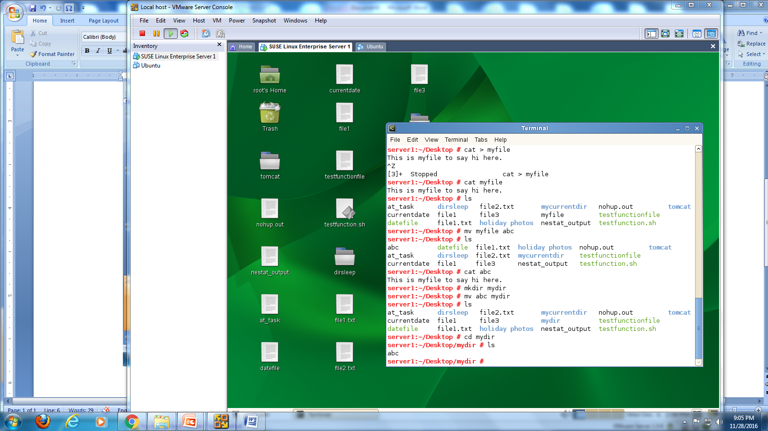

Slide 96
Link Files
A link is a reference to a file.
Hard links
Directory reference or pointer, to a file on a storage volume. When accessed through different names, any changes made will affect the same file data.
two files share the same data (e.g. share the same file size)
Symbolic links
one file is a pointer or shortcut to another
A text string that is interpreted and followed by the OS as a path to another file or directory. If a symbolic link is deleted, its target remains unaffected. If the target is moved, renamed or deleted, any symbolic link that used to point to it continues to exist but now points to a non-existing file🡪 dangling pointer.
Command | Description
ln <existence file> <new filename> | Make a copy of existence file to another file name. Through a link, you can access a file through using different names for it.

Slide 97
Hard Links and Symbolic Links
Both hard and soft (also called symbolic) links are useful for providing alternative names for files and directories.
Instead of having to type a long and difficult path to a file like: /usr/share/doc/package/data/2013/october/10/valuable-information.txt
…a link name for the same file may be simply:
~/valuable.txt
Each technique of linking (hard and soft) has advantages and disadvantages

Slide 98
Understanding the Filesystem
To understand how links work, it is helpful to understand how the filesystem keeps track of files.
For every file that is created, there is one block of data called an inode table that stores the meta-information of the file, such as permissions, ownerships, timestamps and pointers to where the file’s contents are stored.
The inode table includes almost all information about a file except the file name.

Slide 99
Understanding the Filesystem(cont)
Each inode table is associated with a unique inode number.
The ls -i command will display the inode number for each file.
The directory stores the names of all the files within the directory and their associated inode number.
When access is attempted on a file, the system reads the directory data to find the file name and then retrieves its data by looking up the data blocks referenced in its inode.

Slide 100
Hard Link Example
Suppose that the /etc/passwd file has an inode number of 123
The /etc directory would store a table with file names and inode numbers like:
passwd 123
shadow 175
group 144
gshadow 897

Slide 101
Hard Link Example(cont)
A file called /etc/mypasswd that is hard linked to /etc/passwd would also reference inode 123:
passwd 123
mypasswd 123
shadow 175
group 144
gshadow 897

Slide 102
Hard Links
Every file has at least one hard link to it (for the original file name).
The link count number appears between the permissions and the user owner in a detailed listing:
$ echo data > file.original
$ ls -li file.*
278772 -rw-rw-r--. 1 sysadmin sysadmin 5 Oct 25 15:42 file.original
The link count will increase by one for each hard link that is added and decrease by one for each hard link that is removed.

Slide 103
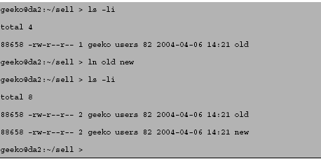
Link Files
Hard links (ln)
You create a hard link by using the ln command.
Notice that the inode is the same for both files and they both have a link count of 2.
103

Slide 104
Soft Links
A soft (symbolic) link is a file that points to another file name.
Soft links have a file type of "l“.
Soft links are similar to shortcuts in Windows.
Several soft links already exist on the system including /etc/motd

Slide 105
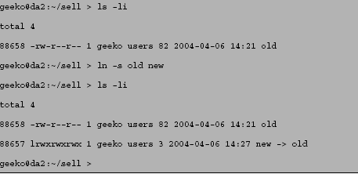
Link Files
Symbolic links (ln –s)
You can create a symbolic link with the ln command and the -s option.
Creating a soft link does not increment the link count on the existing file.
105

Slide 106
Comparing Hard and Soft Links
Hard links have no single point of failure:
Every file name linked to the inode is equivalent.
As long as one hard link remains, then the inode is still accessible.
Soft links have a single point of failure:
If the original file is deleted or moved, then the soft link file will no longer be valid.
An invalid symbolic link is said to be “dangling”.

Slide 107
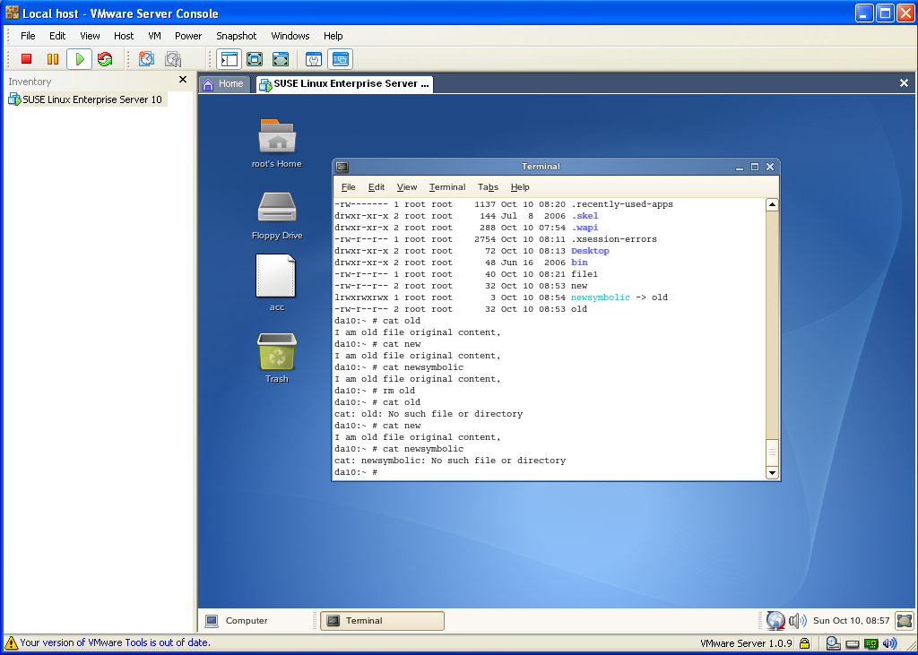
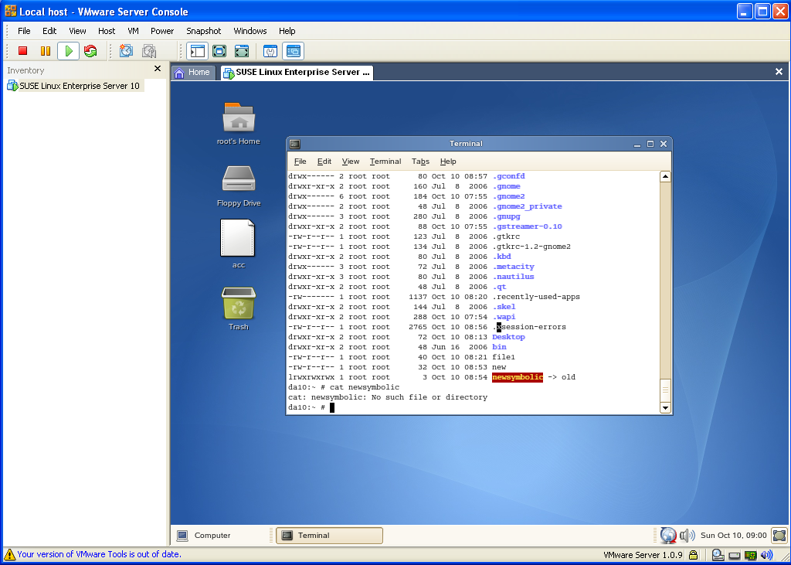
Symbolic links (ln –s)
The disadvantage of symbolic link is that it can point to a non-existing object if the object and its corresponding name no longer exist.
E.g. ln –s old newsymbolic
107

Slide 108
Comparing Hard and Soft Links
Hard links are difficult to see:
A file with a link count greater than one
Can be found with find / -inum 123
Soft links are easy to see:
A link (type l) file
The file name points to what it is linked to

Slide 109
Comparing Hard and Soft Links
Hard links:
Can not link a file on one device or partition to a file on another device or partition
Soft links:
Can cross link from one device or partition to another

Slide 110
Copy Files and Directories
“cp” command
cp source destination
Option | Description
-a | Copies a directory and subdirectories (compare –R); symbolic links, file permissions, owners, and time stamps are not changed.
--help | Display help
-i | Asks before overwriting
-l | Links files instead of copying them (hard link).
-R, -r | Copies directories recursively (the directory and any subdirectories)
-s | Makes symbolic links instead of copying (soft link)
-u cp –u <file> /<directory> | Copies a file only when the source file is newer that the destination file or when the destination file is missing

Slide 111
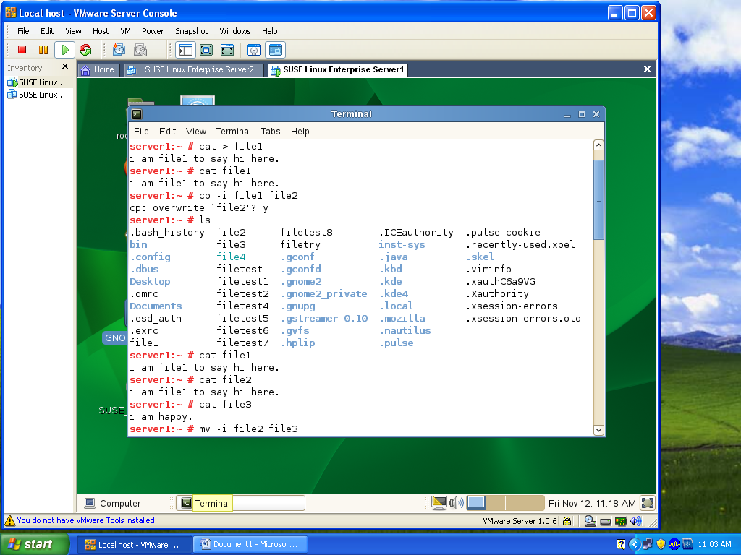

Slide 112
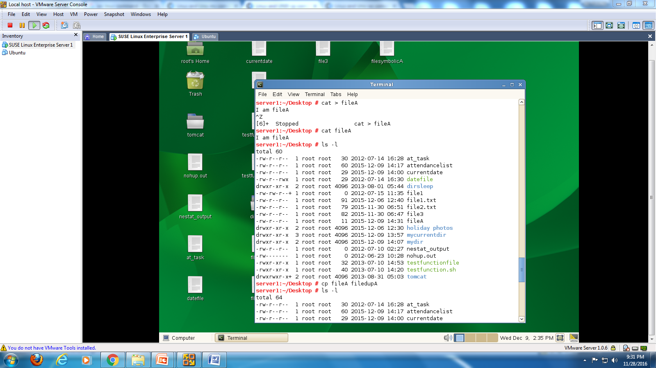

Slide 113
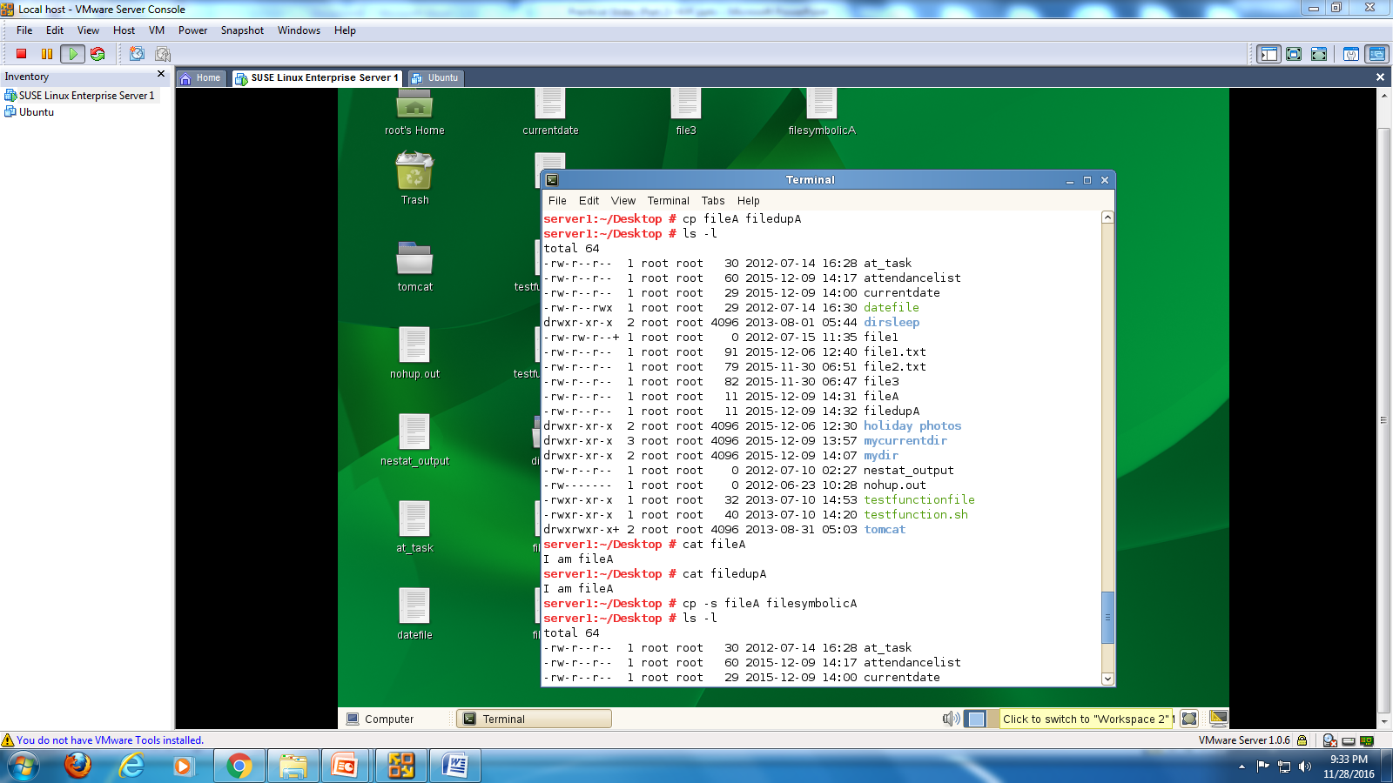

Slide 114


Slide 115


Slide 116
Create and Delete Files and Directories
Command | Description
rm <filename> | Remove a file
mkdir <directory name> | Make a directory
mkdir <directory name> <directory name2> | Make 2 or more directory
mkdir –p <dir1/dir1.1/dir1.1.1> | Make sub subdirectories
rmdir | rm a directory
Option for rm command | Description
-i | Asks for confirmation before deleting
-r | Allows full directories to be deleted (rm –r <directory name>

Slide 117
Wildcard
Wildcards is a token that specifies that one or more different characters can be used to satisfy a specific search request.
Wildcards
?
[…]
*
Any single character
Any single character in the set
Zero or more characters

Slide 118
(?) Matching Any Single Character
Files | Matches | Does Not Match
c? | c1, c2, c3, ca | ac, cat
c?t | cat, cet, cit, c1t | cad, dac
c??t | caat, cabt, cact, c12t | cat, daat, Caat
?a? | bat, cat, far, mar | bed, cur

Slide 119
([…]) Matching Any Single Character From a set
Files | Matches | Does Not Match
f[aoei]d | fad, fed, fod, fid | fud, fab
f[a-d]t | fat, fbt, fct, fdt | fab, fet
f[A-z][0-9] | fA3, fa3, fr2 | FA3, fa33, f^2

Slide 120
(*) Matching Zero or More Characters
Files | Matches | Does Not Match
* | Every file
f* | Every file whose name begins with f (f5c2, fort) | afile, cat
*f | Every file whose name ends in f (staff) | F1, faF
*.* | Every file whose name has a period (file.dat) | bed, cur

Slide 121
Find Files on Linux
Use the “find” command
To search for files on the command line, you can use the find command.
The syntax for the find command is find path criterion action.
Path 🡪 the section of the file system to search (the specified directory and all its subdirectories)
Criterion 🡪 The properties of the file should have (refer to your book)
Action 🡪 Options that influence the following conditions or control the search as a whole, such as –print and –exec command.
E.g.
find ~ -name file1 –print
find ~/Desktop -name myfile –exec cat {} \;
Notes:
If you run find with exec, {} expands to the filename of each file or directory found with find (so that ls in your example gets every found filename as an argument - note that it calls ls or whatever other command you specify once for each file found).
Semicolon ; ends the command executed by exec. It needs to be escaped with \ so that the shell you run find inside does not treat it as its own special character, but rather passes it to find.

Slide 122
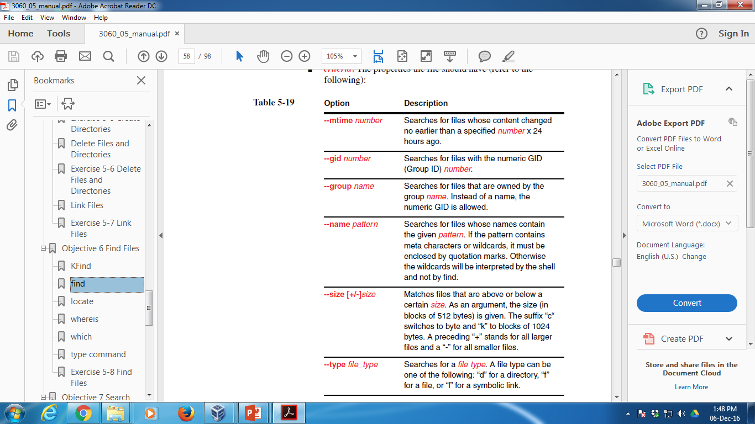
criteon

Slide 123
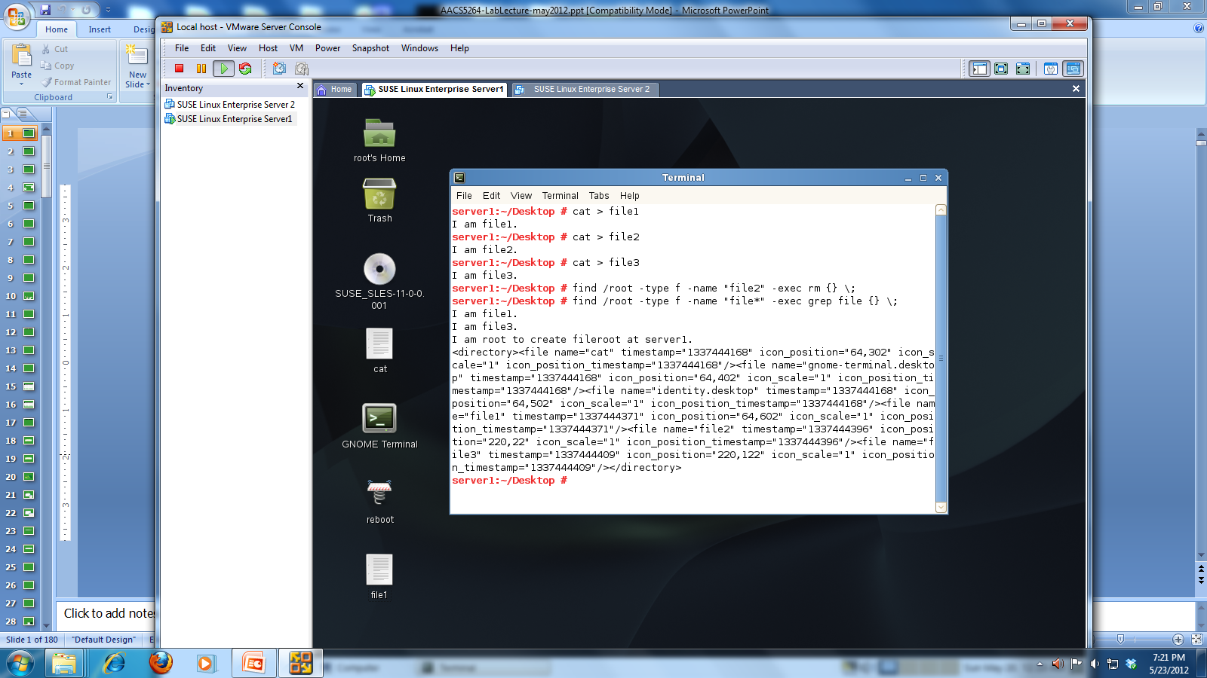
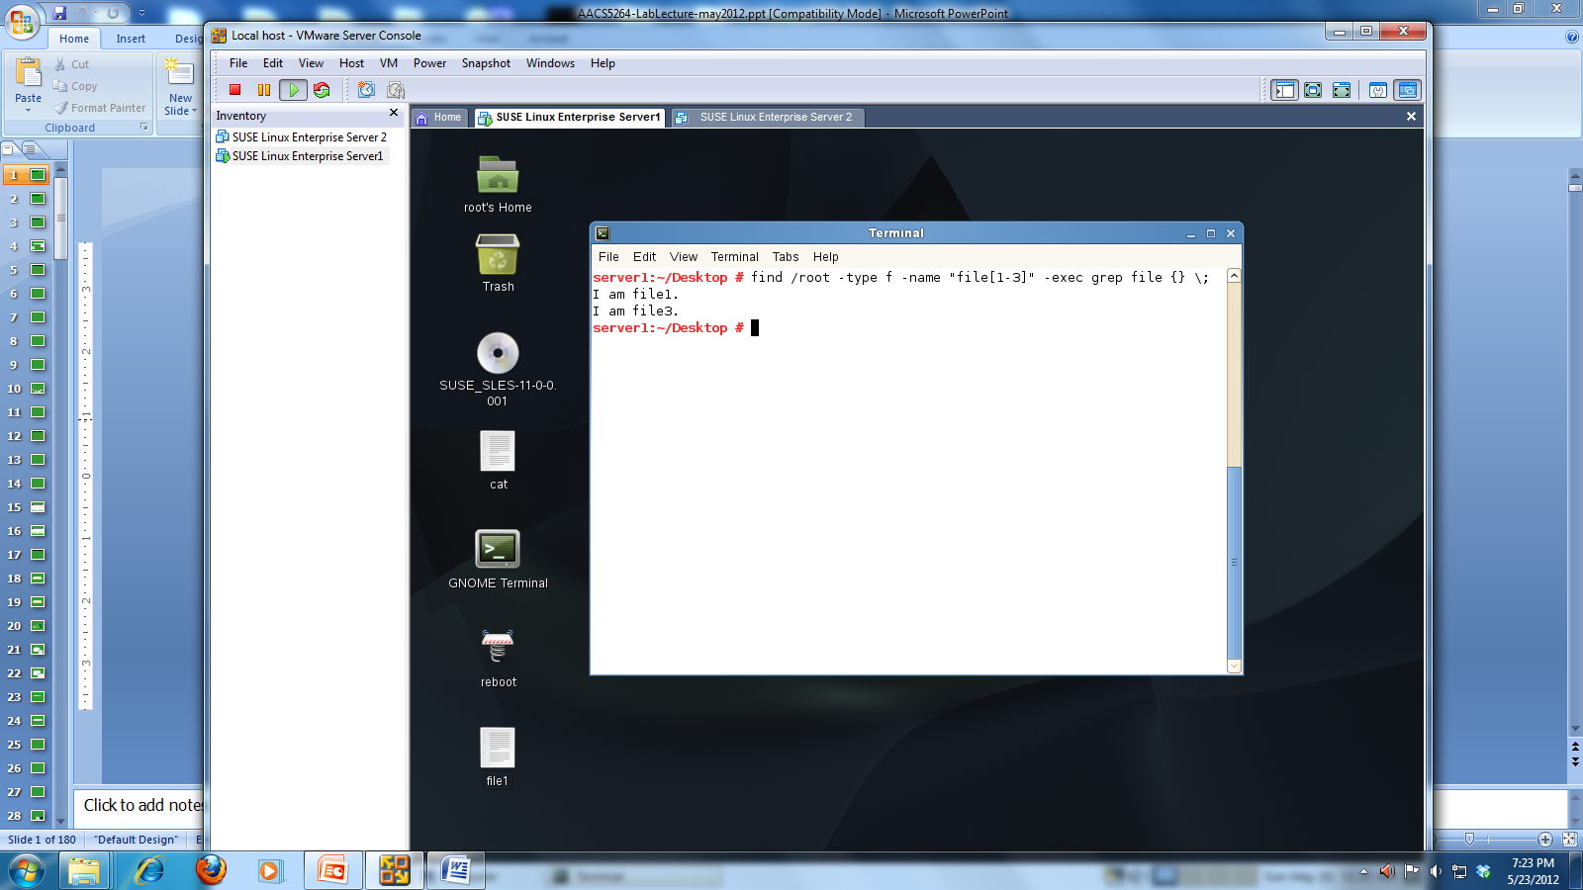
E.g.
find ~ -name “file2” –type f –exec rm {} \;

Slide 124
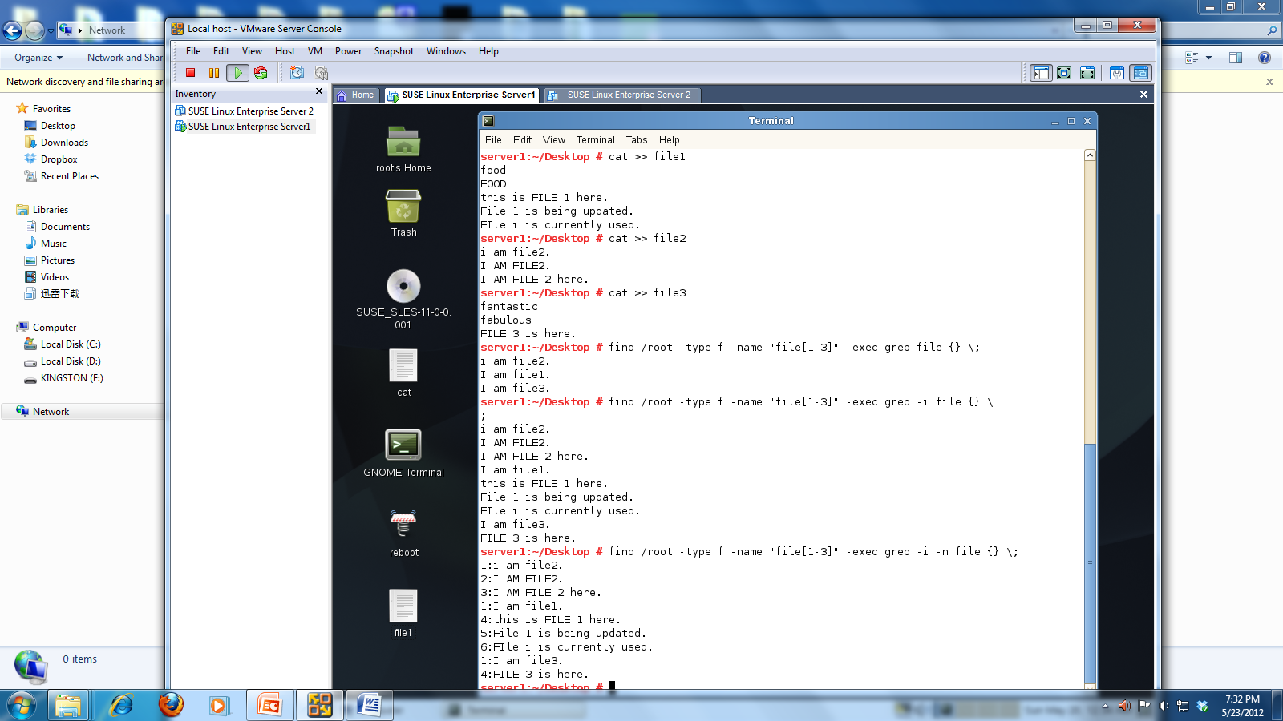
E.g.

Slide 125
Regular Expressions
Regular expressions (regexp): text wildcards that ease the search for specific text
Match patterns of text within a text document
Different from wildcard metacharacters
Wildcard metacharacters interpreted by shell; regexps interpreted by text tools such as grep command and vi text editor.
Wildcard metacharacters match characters in filenames; regexps match characters within text files
Regular expressions are divided into common regexps and extended regexps

Slide 126
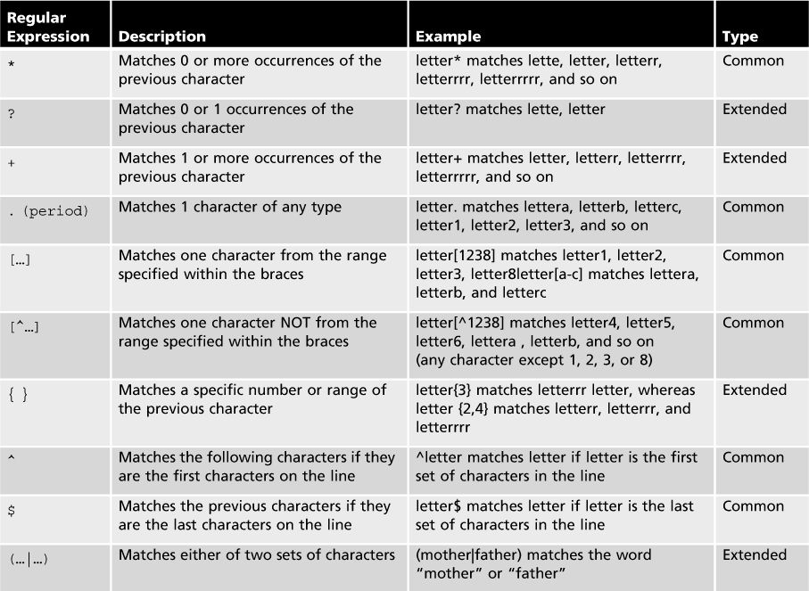
Regular expressions

Slide 127
The grep Command
grep (global regular expression print) command: displays lines in a text file that matching a pattern/regular expression.
grep requires two arguments
Text to search for
Files in which to search
grep is case sensitive
For case-insensitive search, use –i option
grep matches patterns of text, ignoring division into words
To search only for occurrences of a word, surround it by space characters
E.g. grep “we ” project 4

Slide 128
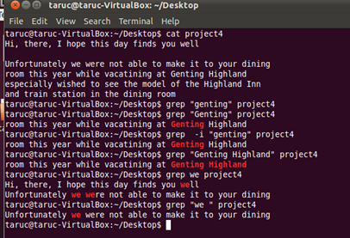

Slide 129
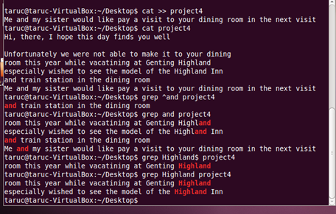

Slide 130
Search File Content
grep <word> <filename> | Search for the word / content in the file. grep apple file1 -i: Ignores case -l: Shows only the names of files that contain the search string -r: Search entire directory tree recursively -v: Gives all lines that do not contain the search string -n: Shows the line numbers [0-9]: Any one from the specified range. (e.g. match any one number from 0 to 9. [^abc]: None of the characters. (e.g. “a”, “b”, “c” are not matched.) .: Any single character (e.g. file. Matches file1 but not file10)

Slide 131
Search File Content
egrep <word> <filename> Or grep –E <word> <filename> | Accepts extended regular expression egrep “(b|B)all” file* egrep “letter+” : matched 1 or more occurrences of previous character (e.g. matches letter1, letterrr, letter and so on) egrep “letter?” : matched 0 or 1 occurrences of previous character (e.g. matches lette, letter and so on egrep “co{1,2}l” : matched both “col” and “cool”

Slide 132
Common UNIX filters
Command | Purpose | Sample
cat | To combine contents of 2 files | cat file1 file2 > file3
head | Print the first 10 lines of a file | head –10 file1
tail | Print the last 10 lines of a file | tail –10 file1
wc | Print the number of lines, words, characters /bytes in a file. | wc file1
sort | Sort the lines in a file alphabetically. | sort file1
spell | Report for words which are not found in the dictionary. | spell file1
grep | Finds text within a file. | grep word file1
diff | Displays two files and prints the lines that are different. | diff file1 file2

Slide 133
wc
wc, or "word count," prints a count of newlines, words, and bytes for each input file.
E.g.
wc myfile.txt
🡪Displays information about the file myfile.txt. Output will resemble the following:
5 13 57 myfile.txt
Where 5 is the number of lines, 13 is the number of words, and 57 is the number of characters/bytes.

Slide 134
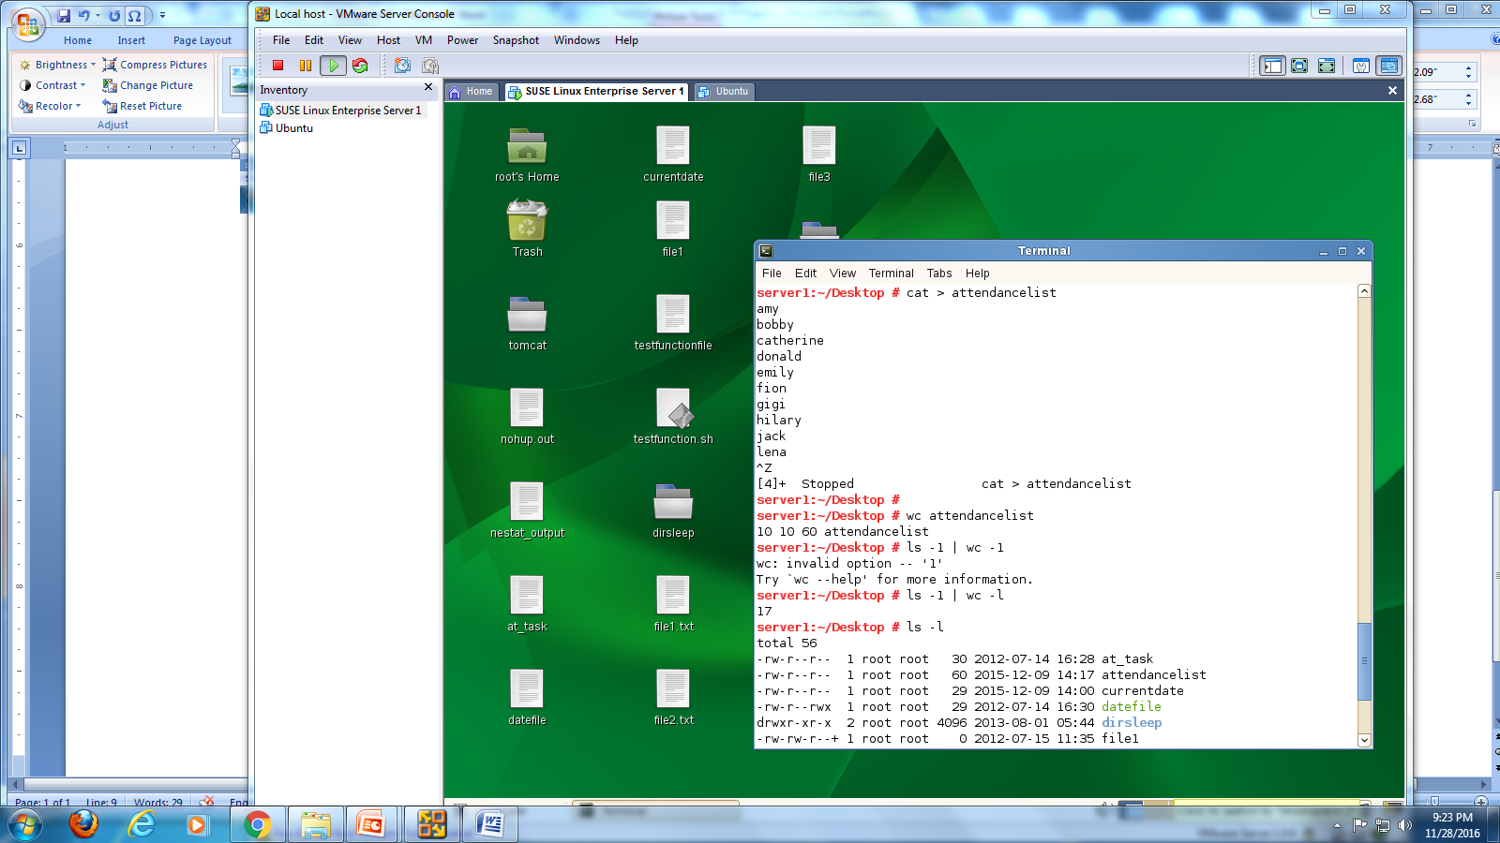

Slide 135
diff
analyzes two files and prints the lines that are different. Essentially, it outputs a set of instructions for how to change one file in order to make it identical to the second file.

Slide 136
Let's say we have two files, file1.txt and file2.txt.
file2.txt contains these four lines:
If file1.txt contains the following four lines of text:
I need to buy apples.
I need to run the laundry.
I need to wash the dog.
I need to get the car detailed.
I need to buy apples.
I need to do the laundry.
I need to wash the car.
I need to get the dog detailed.

Slide 137
diff file1.txt file2.txt
the output will be:
2,4c2,4
< I need to run the laundry.
< I need to wash the dog.
< I need to get the car detailed.
---
> I need to do the laundry.
> I need to wash the car.
> I need to get the dog detailed.
The first line of the diff output will contain:
line numbers corresponding to the first file,
a letter (a for add, c for change, or d for delete), and
line numbers corresponding to the second file.

Slide 138
In our output above, "2,4c2,4" means: "Lines 2 through 4 in the first file need to be changed in order to match lines 2 through 4 in the second file." It then tells us what those lines are in each file:
Lines preceded by a < are lines from the first file;
lines preceded by > are lines from the second file.
The three dashes ("---") merely separate the lines of file 1 and file 2.

Slide 139
Archiving vs. Compression
Archiving collapses multiple files into one
A few files or multiple directories
Compression makes a file smaller
Remove redundant information, replace with a smaller code
Can be applied to individual files, groups of files or entire directory trees

Slide 140
Uses of Archiving and Compression
Managing log files
Sharing groups of files
Project documents
Source code
Compressing for more efficient transfer
Less data to send over the Internet or to tape
Keep like files together grouped by time
Backups

Slide 141
Lossless vs Lossy Compression
Lossless:
Decompressed file is the same as the original
Doesn’t compress as well as lossy
For data you want to preserve
Logs, documents, binaries, configuration
Lossy:
Decompressed file might have lost information from the original
Drops “unimportant” information from the file to make it compress better
Images, sound, movies

Slide 142
gzip vs bzip2
gzip and gunzip
Uses Lempel-Ziv coding
Lossless compression, good efficiency
Bzip2 and bunzip2
Burrows-Wheeler block sorting
Lossless compression, slightly more efficient than gzip, but requires more CPU
Used almost identically as gzip

Slide 143
Using gzip/gunzip/bzip2/bunzip2
gzip myfile # removes myfile; creates myfile.gz
gunzip –l myfile.gz # shows statistics of compressed file
gunzip myfile.gz # removes myfile.gz; creates myfile
bzip2 myfile # removes myfile; creates myfile.bz2
bunzip2 myfile.bz2 # removes myfile.gz; creates myfile

Slide 144
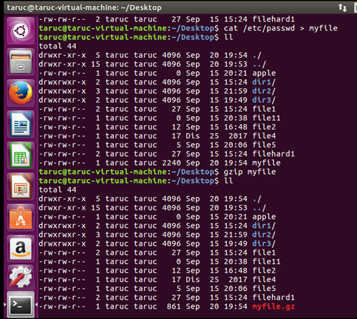

Slide 145
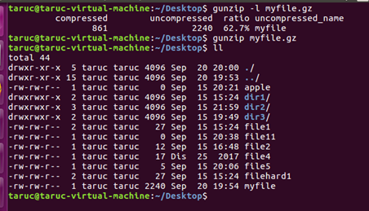

Slide 146
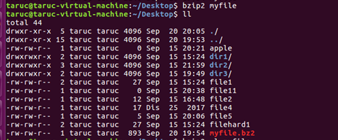

Slide 147
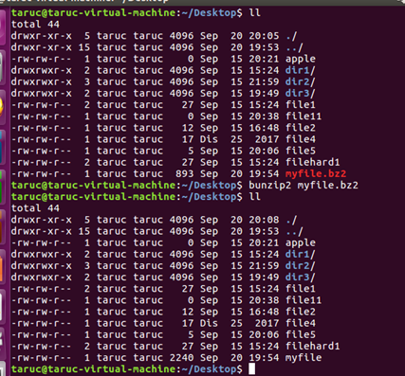

Slide 148
Tape Archive - TAR
tar –cf foo.tar * # c-create an archive under –f archive file name
tar –tf foo.tar # t-list an archive’s contents
tar –xf foo.tar # x-extract files from archive
tar –czf foo.tar.gz * # z-compress an archive with gzip or decompress an archive with gunzip
tar –xzf foo.tar.gz
tar –xf foo.tar file1 # only extract file1 from foo.tar archive file

Slide 149
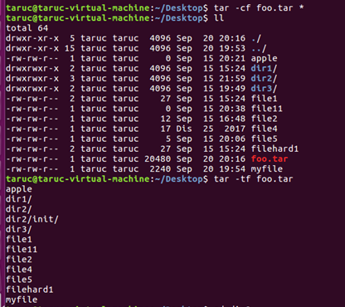

Slide 150
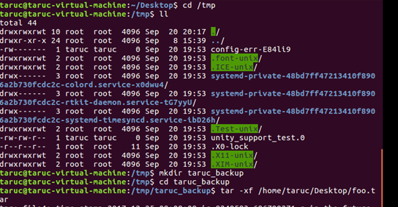
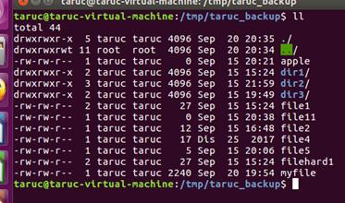

Slide 151
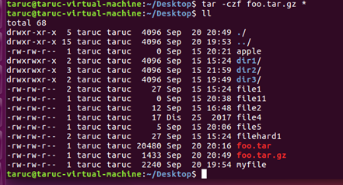

Slide 152
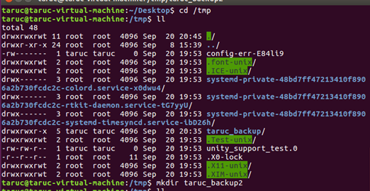


Slide 153


Slide 154
Module 3
Managing Linux Permissions and Ownership

Slide 155
Manage Users, Groups and Permissions Describe Basic Linux User Security Features
File system security components
To control access to files in a Linux file System:
Users | Users are individual accounts on the Linux system.
Groups | Groups are collections of users. Users are assigned to a group when they are created. Every user must belong to at least one group. Only root or the owner of a file can change the group to which the file or directory is assigned.
Ownership | The users who creates a file or directory. Ownership can only be changed by root user.
Permissions | Permissions determine user access to a file or directory.
155

Slide 156
Manage Users, Groups and Permissions Describe Basic Linux User Security Features
User and Group
User accounts and home directories
Each user has a user account
Identified by a login name and a personal password
Each user has her own directory
Regular (normal) users 🡪 Regular user account has its own home directory in the /home/
Privileged user (user root) 🡪 Root is the administrator of the system. Root account has its own home directory in the /root.
The number which a user receives is called a User ID (UID).
Root user always has a UID of 0. UID numbering for normal users starts (by default) at 1000 for Linux.
156

Slide 157

Manage Users, Groups and Permissions Describe Basic Linux User Security Features
User and Group
Using the id Command
You can use the id command to display information about a user’s UID and which groups she is assigned to.
E.g. # id taruc
The command output includes the following:
157

Slide 158

Manage Users, Groups and Permissions Describe Basic Linux User Security Features
User and Group
Using the groups Command
If you want information on the groups in which you are a member, enter groups
groups taruc
E.g. # groups taruc
158

Slide 159
Manage Users, Groups and Permissions Describe Basic Linux User Security Features
User and Group Configuration Files
The Linux system stores all user and group configuration data in the following files:
/etc/passwd
Stores information for each user such as user name, UID, the home directory and the login shell.
/etc/shadow
Stores encrypted user passwords and password expiration information.
The file can only be changed and read by the user root and members of the shadow group.
/etc/group
Stores group information such as group name, GID and the members of the group.

Slide 160
Manage Users, Groups and Permissions Describe Basic Linux User Security Features
User and Group Configuration Files
/etc/passwd
Stores information for each user such as the user name, the UID, the home directory, and the standard shell.
tux:x:1001:100:The Linux penguin:/home/tux/bin/bash
User name password UID GID Comment Home Directory Login Shell
160

Slide 161
Manage Users, Groups and Permissions Describe Basic Linux User Security Features
User and Group Configuration Files
/etc/group
Stores group information such as the group name, the GID, the members of the group.
dialout:x:15:bob,geeko,tux
Group name password GID Group member
161

Slide 162
Manage User and Group Accounts from the Command Line
The user root can use the following commands to perform the same user management tasks:
useradd
Create a new user account
usermod
Modify settings for an existing user account.
userdel
Delete an existing user account.
162

Slide 163
Manage User and Group Accounts from the Command Line
useradd option <username>
option | Description
-m | Automatically generates the new user’s home directory. By default, the user directory is created under /home #useradd –m geeko
-c | For comment, e.g. user full name
-e | For expiration date of the user account (YYYY-MM-DD)
-u | Specifies the UID of the new account. If this option is not given, the next free UID is used. (at maximum 60000)
-g | Specify either GID or the name of the group
-G | This option defines any supplementary groups (separated by a comma) the user should be a member of.

Slide 164
Manage User and Group Accounts from the Command Line
passwd – To establish or change the password of a user account. Then, you will be prompted for a new password and will be asked to confirm it. #passwd geeko
option | Description
-l | Lock the user password (passwd –l kucf)
-u | Unlock the user password (passwd –u kucf)
-S | List the status of a user account (passwd –S kucf)

Slide 165
Manage User and Group Accounts from the Command Line
usermod – To modify settings such as UID, home directory and primary group for an existing user account. The usermod options are basically the same as those for the useradd command.
usermod option <username>
option | Description
-u | Changing user ID #usermod –u 2001 geeko
-d | Changing user’s home directory #usermod –d /data/geeko geeko

Slide 166
Manage User and Group Accounts from the Command Line
userdel option <username> #userdel geeko #userdel –r geeko
option | Description
 | Without –r, user’s home directory is not deleted
-r | User’s account and user home directory is deleted.

Slide 167
Manage groups from the command line
Manage User and Group Accounts from the Command Line
You need to logged on as root to add new group.
option | Description
groupadd | groupadd –g 200 sports
groupdel | Delete a group by entering groupdel group_name
groupmod | Modify the setting (GID, group name, users) for an existing group. groupmod –g 201 sports (change GID) groupmod -n water sports (rename the group)
gpasswd | Change password for group accounts. Only administrator may change the password for any group. To remove the password, use the –r option.
newgrp | Change the effective group of the executing user.

Slide 168

Manage User and Group Accounts from the Command Line
newgrp command
The below example you can see that the current group (taruc) is replaced with a new group (testing).
A password is requested if the group has a password and the user is not listed in the group file as being a member of that group.

Slide 169

Manage File Permissions and Ownership
Understand File Permissions
You can use the ls -l command to display the contents of the current directory with the assigned permissions for each file or subdirectory.
Look at the first ten characters of the output (“-rw-r--r--”). The first character (“-”) is not of interest here, because it indicates the type of the file:
- Normal file
d Directory
l Link
The remaining nine characters show the file permissions.

Slide 170
Manage File Permissions and Ownership
Understand File Permissions
To controls who is allowed to access the file/directory, the permission codes are presented as below:-
read
write
execute
r
w
x
Read (r). This permission allows the file to be read or the contents of a directory to be listed.
Write (w). This permission allows a file to be modified. It allows files to be created or deleted within a directory.
Execute (x). This permission allows a file to be executed.
If a permission is set, the character is shown. Otherwise a “-” appears.

Slide 171
Manage File Permissions and Ownership
Understand File Permissions
The permission characters are grouped (“rwx rwx rwx”):
Characters 1 to 3. These represent the permissions of the file owner. The x permission on a directory is required to be able to change into that directory.
Characters 4 to 6. These represent the permissions of the owning group.
Characters 7 to 9. These represent the permissions of all other users.
Each file (and directory) can belong to only one user and one group.
The name of the file owner (taruc) is shown in the ls output next to the file permissions.
The name of the owning group (taruc) is shown next to the file owner.

Slide 172
Manage File Permissions and Ownership
Change file permissions - chmod
read
write
exec
r
w
x
r
w
x
r
w
x
Owner
Group
Others
Who | User Class | Meaning
u | Owner | Owner of the file
g | Group | Group to which the owners belongs
o | Others | Others users
a | All | All users (owner, group, others users)

Slide 173
Manage File Permissions and Ownership
Command | interpretation
chmod u=rwx file | read, write execute for user
chmod g=rx file | Only read and execute for group
chmod g+x file | Adds execute for group; read and write unchanged.
chmod a+r file | Adds read to all users; write and execute unchanged
chmod o-w file | Removes other’ write permission; read and execute unchanged

Slide 174
Manage File Permissions and Ownership
read
write
exec
r
w
x
r
w
x
r
w
x
4
2
1
4
-
1
4
-
1
Owner
Group
Others
chmod 755 file_name

Slide 175
Manage File Permissions and Ownership
Command | interpretation
chmod 777 file | All permission on for all 3 setting
chmod 754 dir | User all, ,group read + execute ;other read only
chmod 664 file2 | User and group read+write, other read only.
chmod 644 file3 | User read+write, group and others read only.
chmod 711 dir2 | User all, group and others execute only

Slide 176
Manage File Permissions and Ownership
Modify Default Access Permissions with umask
If the default settings are not changed, files are created with the access mode 666 and directories with 777.
To modify these default access mode settings, use the umask command with a 3-digit numerical value such 022.
The permissions set in the umask are subtracted from the default permissions.
For example, entering umask 022 has the following result:
Owner | Directories | Files
Default permissions | rwx rwx rwx 7 7 7 | rw- rw- rw- 6 6 6
umask | --- -w- -w- 0 2 2 | --- -w- -w- 0 2 2
Result | rwx r-x r-x 7 5 5 | rw- r-- r-- 6 4 4

Slide 177
Manage File Permissions and Ownership
Modify Default Access Permissions with umask
By entering umask 077 you restrict access to the owner and root only; the group and others do not have any access permissions.
Enter umask without any parameter to show the current value of the umask.
For example:
#umask
0022
A leading zero can be used to set special file permissions. But for security reasons we strongly recommend against this practice.

Slide 178
Manage File Permissions and Ownership
Change the File Ownership with chown and chgrp
User root can use chown and chgrp as follows:
chown new_user.new_group file
For example,
chown mary.users filejohn.txt
chown new_user file
For example,
chown mary filejohn.txt
chown .new_group file
For example,
chown .users filejohn.txt
chgrp new_group file
For example,
chgrp users filejohn.txt

Slide 179
Manage File Permissions and Ownership
Change the File Ownership with chown and chgrp
A normal user can modify the “group” ownership (not the “owner” ownership) of a file he/she owns
chown .new_group file
For example,
chown .users filejohn.txt
chgrp new_group file
For example,
chgrp users filejohn.txt
The user can only change the group affiliation of the file that he owns if he is a member of the new group.

Slide 180
Module 4
Managing Partitions and the Linux filesystem

Slide 181
Administer the Linux File System
Configure Linux File System
Partitions
To manage partitions through command line use fdisk and to create a file system on that partition using mkfs.
To implement partitions, you need to know the following:
Linux Device and Partition names
Manage Partitions with fdisk
Linux Device and Partition Names
Device | Linux Name
Primary master IDE hard disk | /dev/hda
Primary slave IDE hard disk | /dev/hdb
Secondary master IDE hard disk | /dev/hdc
Secondary slave IDE hard disk | /dev/hdd
First SCSI (or SATA) hard disk | /dev/sda
Second SCSI (or SATA) hard disk | /dev/sdb

Slide 182
Administer the Linux File System
Configure Linux File System Partitions
Partition Names
Partition | Linux Name
First partition on first IDE hard drive | /dev/hda1
Second partition on first IDE hard drive | /dev/hda2
First partition on third SCSI hard drive | /dev/sdc1
First logical partition on first IDE hard drive | /dev/hda5
Second logical partition on first IDE hard drive | /dev/hda6

Slide 183
Administer the Linux File System
Manage Partitions with fdisk
To view current partitioning scheme
$ fdisk –l
To change the partition scheme
$ fdisk /dev/sda
The most frequently used keys are:
-d | Deletes a partition
-m | Gives a short summary of the fdisk command
-n | Create a new partition
p | Shows a list of partition that are currently available on the hard disk specified

Slide 184
Administer the Linux File System
After done the partitioning, it is good to always reboot your machine
After your computer has rebooted, you can use the mkfs, mount, and umount commands to specify the partition device file as an argument.
To create an ext2 filesystem on the /dev/sda2 partition created earlier, you can use the following command:
mkfs –t ext2 /dev/sda2

Slide 185

Administer the Linux File System
Create a File System with Command Line Tools
When using mkfs, you need to use the option -t to indicate the file system type you want to create. If you do not indicate a file system type, mkfs automatically creates an ext2 file system.
For example,
185

Slide 186
Administer the Linux File System
Mount File Systems
In Windows systems separate drive letters represent different partitions.
Linux does not use letters to designate partitions, it mounts partitions to a directory in the file system.
Directories used for mounting are also called mount points.
For example, to add a new hard disk to a Linux system,
1. You partition and format the drive.
2. You then use a directory (such as /data/) in the file system and mount the drive to that directory using the command mount.
To unmount (detach) a file system, you use the umount command (for details, enter man umount).
186

Slide 187

Administer the Linux File System
Configuration File for Mounting File Systems
The file systems and their mount points in the directory tree are configured in the file /etc/fstab. This file contains 1 line with 6 fields for each mounted file system.
187

Slide 188

Administer the Linux File System
View Currently Mounted File Systems
You can view the file systems currently mounted by entering the command mount. Information similar to the following appears:
188

Slide 189
Administer the Linux File System
Mount a File System
You can use the command mount to manually mount a file system.
The general syntax for mounting a file system with mount is
mount [-t file_system_type] [-o mount_options]
device mount_point_directory
E.g.
mount –t ext3 –o rw /dev/hda9 /space
189

Slide 190
Administer the Linux File System
Unmount a File System
Once a file system is mounted, you can use the umount command to unmount the file system.
You can unmount the file system by using umount with the device or the mount point.
For example to unmount a CD file system mounted at /media/cdrecorder, you could enter one of the following:
umount /media/cdrecorder OR
umount /dev/hdb
In order to unmount the file system, no application or user may use the file system.
If it is being used, Linux sees the file system as being “busy” and will refuse to unmount the file system.
190

Slide 191
Administer the Linux File System
Unmount a File System
One way to make sure the file system is not busy is to enter cd / at the shell prompt before using the umount command.
This command takes you to the root of the file system.
However, there might be times when the system (kernel) still sees the file system as busy, no matter what you try to do.
In these cases, you can enter umount -f to force the file system to unmount.
191

Slide 192
Administer the Linux File System
Types of File System:
In the world of Microsoft you never really have to worry about the file system, the default being NTFS.
Linux however, being built on a world of open source and differing opinions, is not limited in this way and so the user should have an understanding of what a file system is, and how it affects the computer.
Source: https://help.ubuntu.com/community/LinuxFilesystemsExplained

Slide 193

Administer the Linux File System

Slide 194
Module 5
Working with the bash shell and shell scripts

Slide 195
Types of Linux Shells
Types of Shells
bourne Shell (/bin/sh)
bourne again Shell (bin/bash) - default shell
korn-Shell (/bin/ksh)
c-Shell (/bin/tcsh)
tc-Shell (/bin/tcsh)
Command
:/ echo $SHELL (check the shell)
:/ exit (to return to previous shell)
Standard
Shell
Bourne
C
Korn
Bash
tcsh

Slide 196
echo $SHELL
To find the shell you have on the default environment you can check the value of the SHELL variable.
$SHELL is not necessarily your current shell, it is the default login shell.

Slide 197
Bourne Shell
Standard UNIX shell.
Used for system administration purpose.
Written by AT&T.
Known for being concise, compact and fast.
Default Bourne Shell prompt is $.
*Bash (bourne again shell) shell is the later (improved version) version of bourne shell

Slide 198
C Shell
Developed at University of California, Berkely.
Provides additional features.
Default C Shell prompt is %.

Slide 199
Korn Shell
Superset of Bourne Shell.
Written by David Korn, AT&T.
Enhancement of Bourne and C shells.
Default Korn Shell prompt is $.

Slide 200
Switching from shell to shell
# bash #Move to Bash shell
# ksh #Move to Korn shell
# csh #Move to C shell
ksh
Bash shell
$ bach
csh
Korn shell
C shell
exit

Slide 201
Variables
Variable: reserved portion of memory containing accessible information
BASH shell has several variables in memory
Environment variables: contain information that system and programs access regularly
User-defined variables: custom variables define by users

Slide 202
Environment Variables
set command: lists environment variables and current values
E.g. # set | less
echo command: view contents of a specified variable
E.g. # echo $SHELL
env command: lists all exported environment and user-defined variables in a shell
E.g. # env
export command: exports user-defined variables to subshells
Ensures that programs started by current shell have access to variables
E.g. # VAR1=“This is a user defined variable”
# env | grep VAR1
# export VAR1
# env | grep VAR1

Slide 203
Environment Variables
Default set of variables used for configuration purposes.
USER - username of a Unix user
HOME - full path to a user's home directory
PATH - list of directories searched for executable files when you type a command in Unix shell
PWD - current directory
SHELL – current shell

Slide 204

Common BASH environment variables

Slide 205

Environment Variables (continued)
Common BASH environment variables

Slide 206
User-Defined Variables
To display the value of a variable: echo $variable
To set the value of a variable or to create a new variable, use the syntax variable=value
The value can be a number, a character, or a string.
If the string includes a space, you have to write the value in full quotes.
Typically capitalized to follow convention
E.g. (no blank space before or after the = sign)
MYVAR=“This is a sample variable”
echo $MYVAR

Slide 207
Variables
Examples (Variables)
x=23
echo $x
Result 🡪23
x=10+2*7
echo $x
Result 🡪10+2*7
let x=10+2*7
echo $x
Result 🡪24
207

Slide 208
Variables
Examples (Variables)
name=“alan”
echo my name is $name
Result: my name is alan
count=7
echo $count is the number
Result: 7 is the number
count=5
number=$count (Assigning one variable to another)
echo $count and $number
Result: 5 and 5
208

Slide 209
Variables
Examples (Variables)
Unsetting
x=1
echo $x
Result: 1
unset x
echo $x
Result:
209

Slide 210
Single Quote, Double Quote, Backslash and Backtick in Variables
Symbol | Meaning | Example
‘ ’ | Always get you exactly what's inside the quotation marks 🡪 treat any characters literally. | ‘This is $SHELL ’ This is $SHELL
“ ” | Assign a string that contains special characters the shell should act on. | “This is $SHELL” This is /bin/bash
\ | To escape (treat literally) a special character that might otherwise operated on | “This is \$SHELL” This is $SHELL
` ` | To assign result of UNIX/LINUX command to a variable | num=1 num=`expr $num + 1` echo $num

Slide 211
Examples
message='Good Morning $USER !' echo $message
Good Morning $USER
message=“Good Morning $USER !” echo $message
Good Morning administrator

Slide 212
Examples
message=“Good Morning \$USER !” echo $message
Good Morning $USER
message=2000 echo $message
2000

Slide 213

Use Piping and Redirection
Linux has three standard data channels:
Standard input (stdin). The currently running program reads the input from this channel (usually the keyboard).
Standard output (stdout). The program sends its output to this channel (usually the monitor).
Standard error (stderr). Errors are issued through this channel (usually the monitor).
213
Notes:
213

Slide 214
Use Piping and Redirection
Each channel can be redirected by the shell. For example, stdin can come from a file or stdout and stderr can be directed to a file.
The following are the redirection characters:
Redirection Character | Description
< | Redirects Standard Input
> | Redirects Standard Output
>> | Redirects standard output, appends to a file
2> | Redirects standard error output
214
Notes:
214

Slide 215

Use Piping and Redirection
Example:
If the standard error output is redirected to /dev/null, only the standard output is displayed on screen.
****Remark:
The null device (/dev/null) is a special file that discards all data written to it and provides no data to any process that reads from it.
215
Notes:
215

Slide 216

Use Piping and Redirection
Example:
In this example, only the standard output result is redirected to the “list” file but not the standard error output result.
216
Notes:
216

Slide 217
Example:
To redirect standard output and standard error output to a file called “list”,
In this example, first, the standard output is redirected to “list” file, then, the standard error output is redirected to the standard output channel(2>&1). The & refer to the file descriptor that follows (1 for the standard output channel).
217
Notes:
217

Slide 218

Use Piping and Redirection
Example:
218
Notes:
218

Slide 219


Slide 220
Use Piping and Redirection
One command’s output can be used as input for another command by using the pipe (“ |” ):
Piping | Description
Command1 | Command2 | Output of one command as the input for another command
Command1 || Command2 | Command2 is only executed if command1 is completed with an errors
Command1 && Command2 | Command2 is only executed if command1 is completed without any errors
220
Notes:
220

Slide 221
Use Piping and Redirection
Example:
geeko@da2:~ > ls /etc | less
geeko@da2:~ > ls –l | tee output
geeko@da2:~ > whoami | tee whoOct2
This tee command read from standard input and write to standard output and files. Typically, tee command is used in conjunction with the pipe (|) symbol so that a program’s output can be both stored and view immediately.
221
Notes:
221

Slide 222
Use Piping and Redirection
geeko@da2:~ > ls recipe || ls ~
🡪 It will execute the second command as well even though the first command is in error.
geeko@da2:~ > ls recipe && ls ~
🡪 It will execute the second command only if the first command is right
222
Notes:
222

Slide 223
Use Piping and Redirection
To redirect the output of several consecutive commands on the command line, the commands must be separated with semi-colons and enclosed in parentheses (command1; command2; ...):
Example:
geeko@da2:~> (id ; ls ~) > output
geeko@da2:~> cat output
uid=1000(geeko) gid=100(users)
groups=14(uucp),16(dialout),33(video),100(users)
bin
Desktop
Documents
output
public_html
geeko@da2:~
223
Notes:
223

Slide 224
Shell Scripts

Slide 225
Definition
A script written for the shell of an operating system.
Often considered a simple domain-specific programming language.
Typically used to automate repetitive tasks and perform simple interactive operations.
Similar to DOS batch files (those files that end in .bat)

Slide 226
Creating Shell Scripts
If you can type it on the command line, it can be scripted
Use a text editor and enter the Linux commands as if you were typing them at the command prompt.

Slide 227
Continue…
Shebang - consists of a number sign and an exclamation point character (#!), followed by the full path to the shell interpreter such as /bin/bash.
#!/bin/sh
cd /tmp echo Removing temp files... ls -al rm junk*
Switch to “tmp” folder
Display message on screen
Show all contents of “tmp” folder in detail view
Save the file as “deltemp”.
Remove those files start with the word “junk”

Slide 228
Executing Shell Scripts
In DOS, we name a batch file with a .bat extension and it'll be recognized as an executable file.
In linux, to make a file executable, you have to mark the file as “executable” (x) by using the chmod

Slide 229
Continue…
Type the following command to make a file executable:
$ chmod +x deltemp
$ ls -l deltemp (to verify)

Slide 230
Continue…
To run the script with ./script no matter which shell the user has
In this case, type the following command to execute the script:
./deltemp

Slide 231
Shebang - #!
#! is the shebang (hash + bang)
Tells the kernel what shell interpreter to use to run the script
Must be on the first line
#!/bin/sh
#!/usr/bin/ruby

Slide 232
Sample (Script Name: Sample1)
# This script displays the date, time, username and current directory.
echo Date and time is:
date
echo
echo Your username is:
whoami
echo
echo -n Your current directory is:
pwd

Slide 233
Arguments and Special Variables
$script_file val1 val2 val3 val4
Arguments are the values you pass to a shell script.
Each value on the command line after the name of the script will be assigned to the special variables $1, $2, $3, and so on.
The name of the currently running script is stored in the $0 variable. (try $# and $*)

Slide 234
Sample of Shell Script (Script Name: Sample2)
Create a script with the following contents:
#!/bin/bash
#This is sample script
echo "The name of this script is: $0”
echo "First pass-in value is: $1" echo "Second pass-in value is: $2" echo "There are $# values passed in." echo "The full argument string is: $*“
echo "The parameters are $@”

Slide 235
Mathematic Expressions
Arithmetic is not built into the Bourne shell.
To perform simple arithmetic calculations ( * / % + -), expr command is needed.

Slide 236
Examples
$expr 1 + 4
5
$expr 1+4
1+4
$expr 5 + 9 / 3
8

Slide 237
Examples
$expr 5 * 4
error
$expr 5 \* 4
20
$num=1
$num=`expr $num + 1`
$echo $num
2

Slide 238

Sample of Shell Script (Script Name: Sample4)

Slide 239
Sample of Shell Script (Script Name: Sample5)
Sequential Logic
let a=1 let b=2 let c=3 let total=$a+$b+$c echo $total

Slide 240

Sample (script1)
#!/bin/bash
#This is sample script
echo "Enter quotient:"
read quotient echo "Enter divisor:" read divider
remainder=`expr $quotient % $divider` echo remainder is $remainder

Slide 241
Making Selection
Conditional Operations (if-then-else)
if [ condition ] then do something else do other things fi

Slide 242
Condition Checking for Numbers
Condition | Meaning | Note
num1 -eq num2 | num1 equals to num2?
num1 -ne num2 | num1 not equal to num2?
num1 -lt num2 | num1 less than num2?
num1 -gt num2 | num1 greater than num2?
num1 -le num2 | num1 less than or equal to num2?
num1 -ge num2 | num1 greater than or equal to num2?

Slide 243
Condition Checking for Characters
Condition | Meaning | Note
str1 = str2 | str1 and str2 are identical?
str1 != str2 | str1 and str2 are not identical?
-n str1 | str1 is not null?
-z str1 | str1 is null?

Slide 244
Condition Checking for Files
Condition | Meaning | Note
-f file | file exists and is an ordinary file?
-d file | file exists and is a directory?
-s file | file contains data ?
-r file | file is readable?
-w file | file is writable?
-x file | file is executable?

Slide 245
Logical Operators
Condition | Meaning | Note
cond1 -a cond2 | both cond1 and cond2 are true?
cond1 -o cond2 | either cond1 or cond2 is true?
! cond1 | cond1 is false (not true)?

Slide 246
Sample (script2)
#!/bin/bash
if [ $1 -gt 2500 ] then echo ‘Your income will be taxed.' else echo Your income will not be taxed.' fi

Slide 247
Sample (script3)
#!/bin/bash
if [ -r $1 -a -x $1 ] then echo “$1 file is readable AND executable”
else
echo “$1 file is NOT readable and executable” fi

Slide 248
Sample (script4)
#!/bin/bash
if [ -z $1 ] then echo ‘Missing value.’
else
echo “Value $1 is entered.” fi

Slide 249
Sample (script5)
#!/bin/bash
if [ ! -d $1 ] then echo ‘Folder does not exist.’
echo “Creating folder $1…”
mkdir $1
else
echo “Folder $1 exists.” fi

Slide 250
Sample (script5a)
Decision Logic (if…then…else)
echo –n “What is your favorite OS?” read OS_NAME if [ “$OS_NAME” = “linux” ] then echo “You will like Linux.” else echo “You should give Linux a try!” fi

Slide 251
Repetition
While statement
Until statement
For statement

Slide 252
WHILE statement
while [ condition ] do something something done

Slide 253
Sample (script6)
while [ "$*" != "" ] do echo "Argument value is: $1" shift done

Slide 254
Sample (script6a)
The While Loop
echo –n “Try to guess my favorite color: ” read guess while [ “$guess” != “red” ]; do echo “No, not that one. Try again. ”; read guess done

Slide 255
UNTIL statement
until [ condition ] do something something done

Slide 256
Sample (script7)
count=1
until [ "$*" = "" ] do echo "Argument number $count : $1" shift count=`expr $count + 1` done

Slide 257
Sample (script7a)
The Until Loop
secretname=jenny name=noname echo “Try to guess the secret name!” echo until [ “$name” = “$secretname” ] do echo –n “Your guess: ” read name done echo “Very good”

Slide 258
FOR statement
for item in list do something something related to item done

Slide 259
Sample (script8)
for number in 1 2 3 4 5 6 7 8 9 10 do echo "Argument value is: $number" done

Slide 260
Sample (script8a)
Looping Logic (for…in) Script Name: adder
#!/bin/sh sum=0 for x in $@ do sum=`expr $sum + $x` done echo “The sum is $sum.” exit 0
To add the input value that entered by user.
./adder 1 2 3 4 5
The sum is 15

Slide 261
Case structure
case $variable in
value1)
command(s)
;;
value2)
command(s)
;;
*)
Command(s)
;;
esac

Slide 262

Sample (script9)

Slide 263
Sample (script9a)
Case Logic
echo –n “Enter A, B, or C: ” read letter case “$letter” in a|A) echo “You entered A.”;; b|B) echo “You entered B.”;; c|C) echo “You entered C.”;; *) echo “Sorry, the letter is not in the list.”;; Esac

Slide 264
Module 6
Managing Linux Jobs and Processes

Slide 265
Describe How Linux Processes Work
Process-Related Terms and Definitions:
These terms are used to describe Linux processes:
Program: structured set of commands stored in an executable file on a Linux file system (e.g. /bin )
Process: program that is loaded into memory and executed by the CPU
User process: process launched by a user that is started from a terminal or within the graphical environment (e.g. mkdir mydir)
Daemon process: system process that is not associated with a terminal or within the graphical environment. Process that wait for an event to trigger an action on the part of the program.

Slide 266

Describe How Linux Processes Work
Process-Related Terms and Definitions
266

Slide 267
Describe How Linux Processes Work
Process-Related Terms and Definitions
These terms are used to describe Linux processes:
Process ID (PID): unique ID assigned to every process as it begins
Child process: a process started by another process (the parent process)
Parent process: a process that starts one or more other processes (child processes)
Parent Process ID (PPID): PID of the parent process that created the current process

Slide 268

Describe How Linux Processes Work
Process-Related Terms and Definitions
The following illustrates the relationship between parent and child process ID numbers:
Parent
Child
Child
Figure 2. Parent and child Processes

Slide 269
Describe How Linux Processes Work
Process-Related Terms and Definitions
The first process started by the Linux kernel is the initialize (init) daemon, which has a PID of 1 and a PPID of 0
The latter (PPID 0) of which refers to the kernel itself
The init daemon then starts other daemons during the system initialization process, such as user logins.
After you login to the system, the login program starts a BASH shell.

Slide 270
Manage Linux Processes
Managing Foreground and Background Processes
Processes executed in the foreground
Initialized in a terminal window & executes until the process completes
During the time the process is running, the terminal window does not return to a prompt until the program execution is complete
Processes executed in the background
Initialized in a terminal window but the terminal window returns to a prompt before the process finishes executing
Processes can be switched from foreground to background
270

Slide 271

Manage Linux Processes
Managing Foreground and Background Processes
Switch process from foreground to background
E.g. If you enter xeyes to start the XEYES program, it is running in the foreground.
271

Slide 272

Manage Linux Processes
Managing Foreground and Background Processes
Switch process from foreground to background
E.g. If you press Ctrl + Z, the process stops.
272

Slide 273

Manage Linux Processes
Managing Foreground and Background Processes
Switch process from foreground to background
E.g. You can continue running a stopped process in the background by entering bg.
The ampersand (&) displayed in the output indicates the process is now running in the background.
273

Slide 274

Manage Linux Processes
Managing Foreground and Background Processes
Switch process from foreground to background
E.g. Appending an ampersand (&) to a command starts the process in the background instead of the foreground (it does return the system prompt).
In the following example, both the job ID ([2]) and the process ID of the program (5878) are returned.
274

Slide 275

Manage Linux Processes
Managing Foreground and Background Processes
Each process that is started from the shell is assigned a job ID by the job control of the shell.
The jobs command lists the contents of the job control.
275

Slide 276

Manage Linux Processes
Managing Foreground and Background Processes
In this example, Process 1 and 2 are running in the background (notice the &).
The plus (+) sign indicates the process that will respond to fg
The minus (-) sign indicates the process that will inherit the + sign once the process currently with the + sign ends.
276

Slide 277

Manage Linux Processes
Managing Foreground and Background Processes
You can switch a particular process run in background to the foreground by entering fg job_ID, as in the following. (Eg fg 1)
277

Slide 278
Manage Linux Processes
Managing Foreground and Background Processes
Ctrl + Z
Stops a process running in foreground
bg
Continues running a stopped process in the background
Ampersand (&)
Starts the process in the background
fg job_ID
Switches a process to the foreground
Process Termination Status
Done (process terminated properly)
Terminated (process received a request to terminate)
Killed (forceful termination of a process)
278

Slide 279


Manage Linux Processes
Viewing and Prioritizing Processes
ps
Lists all running processes
Some of the commonly used ps command options are as follow:-

Slide 280

Manage Linux Processes
Viewing and Prioritizing Processes
E.g. if you enter ps axl, the output is shows as follows:-
priority
Process ID
Parent ID
280

Slide 281


Manage Linux Processes
Viewing and Prioritizing Processes
E.g. if you enter ps aux, the output is shows as follows:-
E.g. Following is a description of some of the fields displayed in the output of the ps command:
281

Slide 282
Manage Linux Processes
Code | Description
R (Runnable) | Process can be run
S (Sleeping) | Process is waiting for an external event
D (Uninterruptable sleep) | Process cannot be terminated at the moment
T (Traced / Stopped) | Process is suspended
X | Process is dead
Z (Zombie) | Process has terminated itself, but the return value has not yet been returned

Slide 283

Manage Linux Processes
Viewing and Prioritizing Processes
pstree - Lists processes in the form of a tree structure
283

Slide 284
Manage Linux Processes
Viewing and Prioritizing Processes
nice
Assigns a process with a specific nice value
Nice value indicates the process priotity
If a nice value is not entered, the process initializes with the value of +10
Nice level is assigned using a numeric value of -20 to 19
The lower the value of the nice level, the higher the priority of the process.
Nice level is used by the scheduler
To determine how frequently to service a running process
Only root is permitted to start a process with a negative value
E.g. nice –n -3 xeyes
284

Slide 285
Manage Linux Processes
Viewing and Prioritizing Processes
renice
Changes the nice value of a running process
E.g. renice 5 1712
PID 1712 with new nice value of 5
Only root can reduce nice value of a running process (i.e. from 10 to 9)
All other users can only increase the nice value (i.e. from 10 to 11)
285

Slide 286

Manage Linux Processes
Viewing and Prioritizing Processes
top
Allow you to view process information in a continuously updated list.
The displayed list is sorted by computing time and is updated every 3 seconds.
You can terminate the display by typing q.
286

Slide 287
Manage Linux Processes
Viewing and Prioritizing Processes
top [options]
E.g. top –d 5
Changes the default delay (5 seconds)
E.g. top –b
Batch mode. When you want to write the output of top to a file
E.g. top –n 3
To cause the top to quit after the third refresh
287

Slide 288
Manage Linux Processes
Ending a Process
kill and killall
Terminate a process
killall
Kills all processes with an indicated command name
Needs the command name of the process
kill
Kills only the indicated process
Needs the PID of the process
For example, if you enter xeyes at the command line to start the xeyes program (and the PID is 18734), you can enter kill 18734 or killall xeyes to end the process.
Note: Use jobs –l to list the PID of a process
288

Slide 289
Delayed and Detached Jobs
Linux allows you to delay and even detach jobs, facilitating efficient utilization of system resources.
Delay a job – A delayed job is a job that can be run at a specified time after the command is issued. For example, a CPU intensive job that slows down the system can be delayed until off-peak work hours.
Detach a job – A detached job is a job that can be set to run after you log out of the system. For example, a task that will not be completed until you leave can be set to continue running even after you log out (detached) of the system.

Slide 290
Delay a job using sleep command
To delay the start of a job, use the sleep command followed by the delay in seconds and the command name.
sleep NUMBER [SUFFIX]
where SUFFIX may be:
s for seconds (the default)
m for minutes.
h for hours.
d for days.
To sleep for 5 seconds, use:
sleep 5
To sleep for 2 minutes, use:
sleep 2m
To sleep for 3 hours, use:
sleep 3h

Slide 291

Delay a job using sleep command
E.g sleep 5; date
Here is a simple example of sleep command in shell script:

Slide 292
Detach a job using nohup command
If you have a task that cannot be completed until after you leave work, or you have a task that is CPU-intensive and may slow the system, you can start the task before you leave and specify that it continues even after you logout of the system.
You can do this by using the nohup (no hangup) command.
The nohup command should run in the background so that it does not tie up your terminal. To enable a command to run in the background after you have logged out, use the syntax
nohup [command] &
Example: nohup find -size +100k > log.txt &
In this case, it will run the find command, instructing it to search for any file bigger than 100 kilobytes. find will continue to search even if the user logs out, and write its results to file log.txt.
Example: nohup myLongRunningJob.sh &
In this case, if you want to log off and go home for the night, but you need to run a job (process) on your Linux system that's going to take a couple of hours.

Slide 293
Scheduling Commands
Schedule Jobs (cron)
To carry out jobs on a regular basis by using the cron service (/usr/sbin/cron)
The services run as daemon and checks every minute to see if jobs have been scheduled.
Crontab (CRON TABle) is a file which contains the schedule of cron entries to be run and at specified times.
Two types of jobs can be defined with cron:
System Jobs
User Jobs

Slide 294
Scheduling Commands
System Jobs
To control system jobs, you can add lines to /etc/crontab file.
For a detailed description of the syntax for /etc/crontab, enter
man 5 crontab.
Cron also has a way to specify crontabs at “system” level.
The /etc/crontab file and the files in /etc/cron.d are “system crontabs”.
/etc/cron.hourly | Jobs are run on an hourly basis.
/etc/cron.daily | Jobs are run on a daily basis.
/etc/cron.weekly | Jobs are run on a monthly basis.
/etc/cron.monthly | Jobs are run on a yearly basis.

Slide 295
Scheduling Commands
System Jobs
Example:
The key difference is the insertion of a field between the “day of week” field and the command field. This field is “run as user” field. Thus:
02 4 * * * root run-parts /etc/cron.daily
will run “run-parts /etc/cron.daily” as root at 2 minutes past 4 a.m. every single day.

Slide 296
Scheduling Commands
User Jobs
The jobs if individual users are stored in the /var/spool/cron/tabs/ directory in files matching the usernames.
These files always belong to the user root.
Crontab Commands
crontab -e | Edit your crontab file, or create one if it doesn't already exist
crontab -l | Display your crontab file.
crontab -r | Remove your crontab file.
crontab -v | Display the last time you edited your crontab file. (This option is only available on a few systems.)

Slide 297

Scheduling Commands
Crontab File A crontab file has five fields for specifying day , date and time followed by the command to be run at that interval.
* * * * * command to be executed - - - - - | | | | | | | | | +----- day of week (0 - 6) (Sunday=0) | | | +------- month (1 - 12) | | +--------- day of month (1 - 31) | +----------- hour (0 - 23) +------------- min (0 - 59)
Notes:
Touch output.txt

Slide 298
Scheduling Commands
Use of operators
An operator allows you to specify multiple values in a field. There are three operators:
The asterisk (*) : This operator specifies all possible values for a field. For example, an asterisk in the hour time field would be equivalent to every hour or an asterisk in the month field would be equivalent to every month.
The comma (,) : This operator specifies a list of values, for example: "1,5,10,15,20, 25".
The dash (-) : This operator specifies a range of values, for example: "5-15" days , which is equivalent to typing "5,6,7,8,9,....,13,14,15" using the comma operator.

Slide 299

Scheduling Commands
Table 1 Common at commands
Scheduling commands with at
The at command daemon can be used to schedule a command to execute once in the future
Some common time formats used with the at command are listed in Table 1
Note: sudo apt install at
Notes:
at now
echo “schedule at job now" >> ~/Desktop/output.txt

Slide 300

Scheduling Commands
Scheduling commands with at
To schedule the command date and who to run at 10:15 PM on July 15th

Slide 301

Scheduling Commands
Scheduling commands with at
To display a list of at job IDs, you can specify the –l option to the at command

Slide 302

Scheduling Commands
Scheduling commands with at
To see the contents of the at job listed in the previous output alongside the shell environment at the time the at job was scheduled, specify the -c option to the at command

Slide 303

Scheduling Commands
Scheduling commands with at
To remove the at job used in the preceding example, specify the -d option to the at command.
Alternatively, you can use the atrm command to remove the job.

Slide 304
Module 7
Managing Packages
Source: https://www.digitalocean.com/community/tutorials/package-management-basics-apt-yum-dnf-pkg

Slide 305

Software Installation
Most Linux distributions today, including Fedora, use the Red Hat Package Manager (RPM)
However, Debian and Debian-based Linux distributions, such as Ubuntu Linux, such as Ubuntu Linux, use Debian Package

Slide 306

Software Installation
Advanced Package Tool (apt-get)

Slide 307


Slide 308
Software Installation
Install package through terminal:
sudo apt-get install <package>
Uninstall a software through terminal:
sudo apt-get remove <package>
Installing package dependencies:
sudo apt install -f

Slide 309


Slide 310


Slide 311


Slide 312


Slide 313


Slide 314


Slide 315

Aptitude Utility (aptitude)

Slide 316
Aptitude Utility (aptitude)
Same arguments as “apt-get”
Install the DPM package
aptitude install package
Remove the installed DPM package excluding configuration files
aptitude remove package
Remove the installed DPM package including configuration files
aptitude purge package

Slide 317
Software Installation
Install Wine
Running Windows Programs on Ubuntu
For example, LibreOffice works on both Windows and Ubuntu systems, but Microsoft Office works only on a Windows system.
Since many Windows users who use Ubuntu want all of their Windows programs back, many programmers have worked together to create Wine.
Wine is an acronym for “Wine Is Not an Emulator”. This section will discuss what Wine is, and how to use it on your Ubuntu installation.

Slide 318

Installing “wine”
Source: http://files.ubuntu-manual.org/manuals/getting-startedwithubuntu/16.04

Slide 319
Module 8
Managing kernel services

Slide 320
Explore the Linux Kernel
The kernel is the core of an operating system and all other components rely on it.
It is loaded first and remains in the main memory.
It contains system-level commands and other functions that are hidden from users.
The kernel manages file system access, memory, processes, devices, and resource allocation on a system
The kernel also controls all the hardware devices plugged into the system.
The kernel initializes itself during the boot process and then starts running the other processes. By default, the kernel loads with a minimal set of functions required to run a system.

Slide 321

Kernel Layers
Kernel Layers
The kernel performs various functions to control and manage the operations of a system. It is composed of various layers.
Kernel layers compose of:-
System call interface (SCI)
Process Management
Memory management
File system management
Device management

Slide 322
Identifying Linux Kernel Versions
Linux kernel versions are composed of:
Major number
Minor number
If odd, referred to as a developmental kernel: a kernel which is not fully tested and with implied instability.
If even, referred to as a production kernel: a kernel that has been thoroughly tested and is declared to be stable.
Revision number
The linux kernel version number can be viewed using the uname -r command.

Slide 323

Latest revisions of common Linux kernels

Slide 324
Directories Containing Kernel Modules
The /lib/modules directory contains the modules of different kernel versions that are installed.
It contains a directory named after the kernel's version number. A list of currently loaded modules is found in the /proc/modules file. Modules are stored across various directories based on the categories they belong to.
The following table (next slide) lists the directories containing modules.

Slide 325


Slide 326

Kernel Module Managing Utilities

Slide 327

Command Options for modinfo

Slide 328


Types of Kernel Configuration

Slide 329


The /proc Directory
The /proc is a directory which contains a Linux virtual filesystem, which provides elaborate information about the kernel's running process. Some of the files in the /proc directory are listed in the following table.

Slide 330

The sysctl Command
The sysctl command is used to view or set the kernel parameters at runtime. It has various options.
The syntax of the sysctl command is:
sysctl [options] {kernel parameter} = {value}

Slide 331


Slide 332
Create an initrd Image
The initial ramdisk image (initrd image) consists of all the kernel modules that were loaded during the boot process.
Additional modules that are installed also need to be added to the initrd image to load them automatically at boot time.
The existing kernel on your system may have all the necessary modules, but at a later stage, you may need to update the modules when a new set of devices have to be supported.
There is no need to create an initial ramdisk image manually as this step is automatically performed if the kernel and its associated packages are installed or upgraded by using apt

Slide 333
The mkinitrd Command
The mkinitrd command is used to create the initial ramdisk image for preloading the kernel modules.
In Ubuntu platform, we have to use the command “mkinitramfs” instead of “mkinitrd” command.
E.g.
sudo mkinitramfs -o /boot/new-ramdisk-image.img
Notes:
ls /boot | grep new-ramdisk-image.img

Slide 334
Manage Device Drivers and Hardware Devices
Drivers are associated directly with the hardware devices that are installed on your computer.
A system administrator has to read and write details to the driver files frequently when additional hardware is required or existing hardware is upgraded. Knowing how to access drives through the /dev directory will enable you to handle this task effectively.
The /dev directory includes hardware and software device drivers.

Slide 335
Coldplug vs. Hotplug
Hotplug is the ability of a system to add or remove hardware without rebooting the system, while coldplug is the inability to do so.
Hotplug devices are detected by the system as they are plugged in whereas coldplug devices, such as conventional hard disks, are not sensed when connected to a running system; they need a complete reboot of the system to function.
Some coldplug devices, such as hard disk, PCI, and RAM, can be connected only when the system is not running.

Slide 336
Device Drivers
A device driver is a software program that enables a computer's operating system to identify the characteristics and functions of a hardware device, communicate with it, and control its operations.
It acts as an interface between the operating system and hardware devices such as hard drives, CD/ DVD drives, printers, scanners, monitors, and keyboards. Device drivers can be part of the operating system or installed on demand.

Slide 337


Slide 338

Types of Hardware Devices
Hardware devices can be divided into two types based on their usage or function.

Slide 339


Special Devices
Linux provides a few special character devices that are used occasionally.

Slide 340
HAL
The Hardware Abstraction Layer (HAL) is a logical interface that enables software applications to interact with hardware devices at an abstract level through system calls.
This layer converts generic system calls sent by software applications to detailed device-specific instructions.
It enables an operating system to adapt to different kinds of hardware platforms without requiring any modification in the kernel.

Slide 341


Slide 342

The HAL utilities enable you to view or monitor the hardware device connected to the computer.

Slide 343

Monitor Processes and Resources
Kernel State Monitoring Utilities
Kernel state monitoring utilities are used to gather information about the operating system and its running events and processes. The kernel state monitoring utilities are listed in the following table.

Slide 344

Memory Monitoring Utilities
Memory monitoring utilities are used to view the usage of memory and other related statistics.

Slide 345

Command Options for the free Utility

Slide 346

Command Options for the vmstat Utility

Slide 347
Process Monitoring (Covered Previously)
Process monitoring is a mode of tracking the processes running on a system, to determine its performance and reliability.
Process monitoring enables a user to identify the causes of low performance in processes and detect the processes run by unauthorized users.
The ps command allows you to view the running processes on a system.

Slide 348

Process Monitoring (Covered Previously)

Slide 349
The GNOME System Monitor
Search for “System Monitor”
The GNOME system monitor is a GUI utility that is used to monitor system processes, resources and filesystems.
The Processes tab displays details about the currently running processes such as the name, status, ID, and CPU and memory usage.
The Resources tab displays the history of CPU, memory, and swap usage and network operations. The File Systems tab displays information about currently mounted filesystems, related directories, type, and usage status.

Slide 350

The GNOME System Monitor

